Slide 1
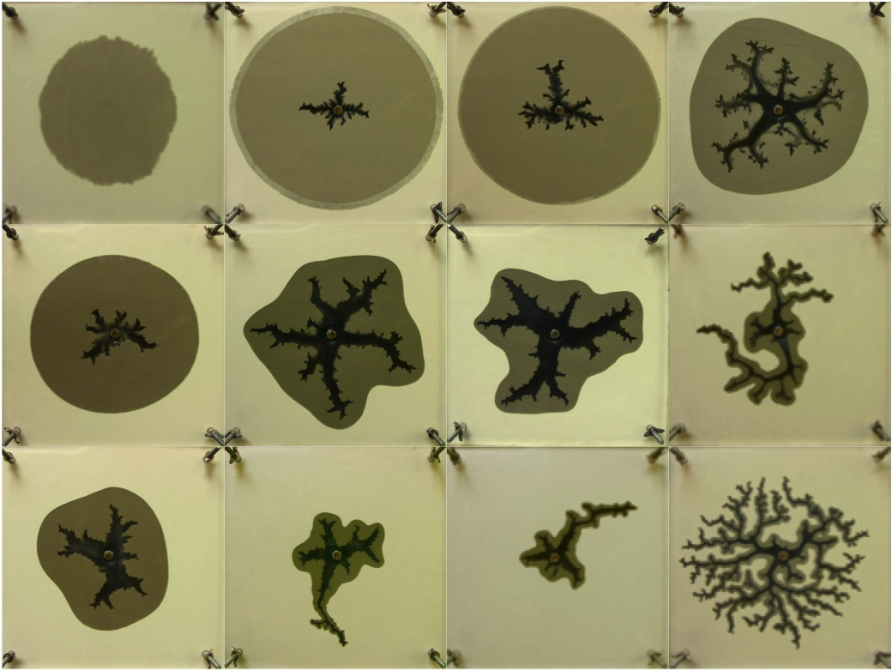
Pattern Formation in Fluid Injection into Granular Media:
Transition from Viscous Fingering to Hydraulic Fracturing
Haiying Huang, School of Civil and Environmental Engineering
Georgia Institute of Technology
Flow velocity
Displacement patterns created when aqueous glycerin solutions at various concentrations were injected into a Hele-Shaw cell filled with dense dry sands. The displacement patterns emerge as a result of competition among various mechanisms of energy dissipation and range from simple radial permeation for the low velocity and low viscosity case to the viscous fingering type of pattern for the high velocity and high viscosity case.
Fluid viscosity
Light colored area – dry sands only; black area – fluid only (no grains);
brown area – infiltrated area (fluid and sand grains)

