Slide 1
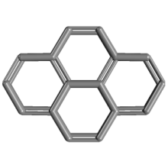
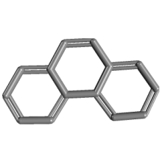
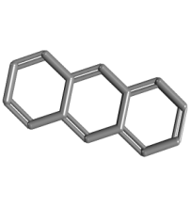
Solution medium effects on the photolysis of polyaromatic hydrocarbons (PAHs) in aqueous medium Catherine D. Clark , Warren J. De Bruyn, Chapman University, Orange, CA
Introduction
PAHs are carcinogenic compounds formed from fossil fuel combustion. They are degraded by sunlight in natural waters. Our study examines the effect of salts and humic acids (produced from degrading plants) on the rates, pathways and products of PAH photolysis in water.
Some results to date
Anthracene
A solar simulator was used for irradiation to mimic natural sunlight. Photolysis rate constant was ~0.5 s⁻¹ No salt effect on the rate was observed, but the photolysis rate decreased by a factor of 5 with the addition of humic acid (due solely to competitive absorption of the light by the humic acid based on model calculations).
Phenanthrene
A higher energy xenon lamp was used for irradiation as no detectable decay was seen with the lower radiation levels of the solar simulator. Photolysis rate constant was ~0.04 s⁻¹ with the lamp (equivalent to ~0.004 s⁻¹ with the solar simulator, or about 100 times slower than observed for anthracene). No salt effect was observed, but photolysis rates again decreased with added humic acid due to absorption of the light by the humic acid decreasing the amount of light available for PAH photolysis.
pyrene
phenanthrene
anthracene
Molecular structures
Preliminary conclusions
These results contrast with those we previously obtained for pyrene, which exhibited: 1) a salt effect suggesting the role of charged species in a rate limiting step in the kinetic mechanism; and 2) significant DOM inhibition beyond simple competitive absorption. This suggests that these PAHs: 1) undergo different photodegradation pathways , possibly via a photoionization
mechanism for pyrene vs.direct photolysis for phenanthrene and anthracene; and 2) have different binding constants to humic acid, with pyrene being more strongly bound and its photolysis thus affected beyond simple light absorption effects.
Fig
experiments
theoretical
Fig. 1 Rate constant vs. square root
of ionic strength (a measure of
salt concentration)
Fig. 2. Rate constant vs. humic acid
concentration. Open symbols:
experiments; lines: theoretical from a
competitive light absorption model.

