Slide 1
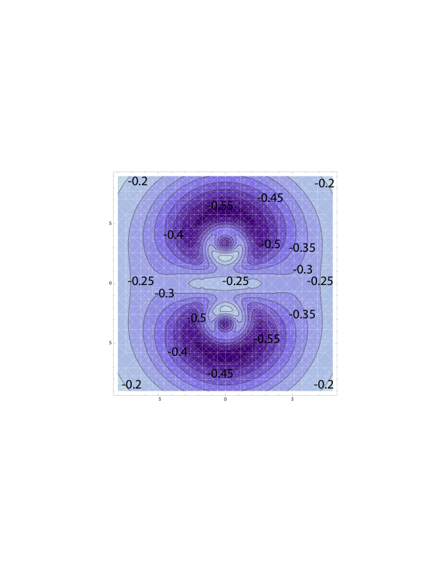
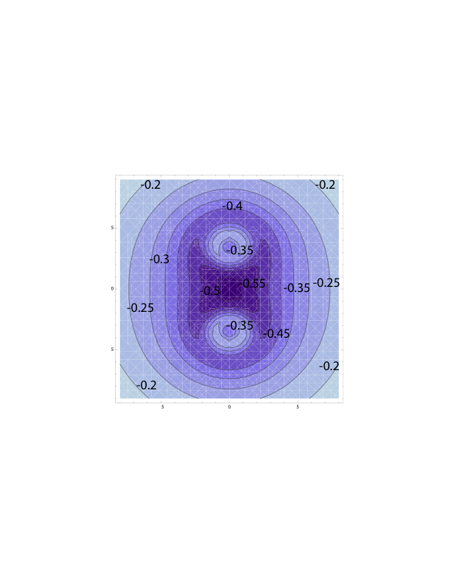
Solving the Schrodinger Equation Accurately with Fewer Electrons:
the Development of Coordinate-Dependent Pseudopotentials
Benjamin J. Schwartz, Dept. Chem. & Biochem., UCLA 45988-AC,6
• Solving the Schrödinger Equation for many-e¯ systems is expensive; the number of e¯’s in
the equation can be reduced by using pseudopotentials to treat some e¯’s implicitly
• Unfortunately, pseudopotentials treat the implicitly-treated e¯’s as frozen, so that chemical
bonds and other features of complex quantum systems are not accurately described
• We have developed a new method that allows pseudopotentials to respond to changes
in chemical structure and dynamics, effectively ‘unfreezing’ the implicitly-treated e¯’s.
This method significantly descreases the computational time needed to perform
quantum simulations of complex chemical systems in realistic chemical environments
Standard (‘frozen e¯’)
pseudopotential for
the Na₂ molecule at
its equilibrium distance
New pseudopotential
that accurately reprod-
uces the behavior of Na₂

