Slide 1
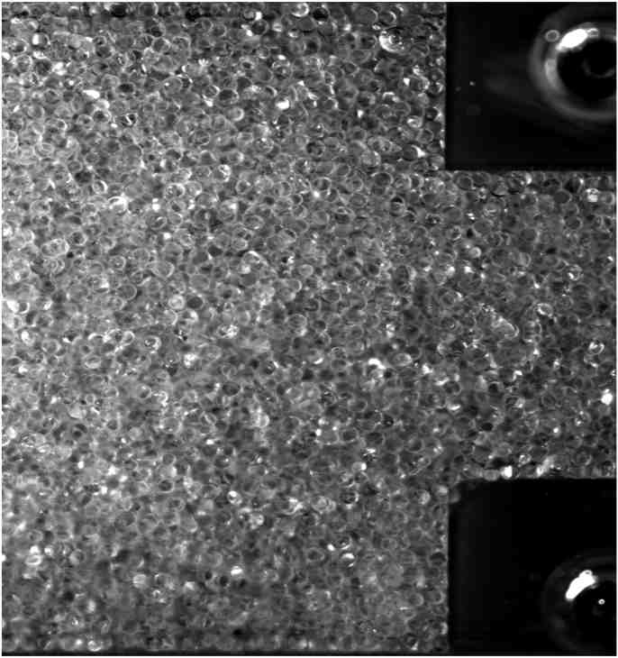
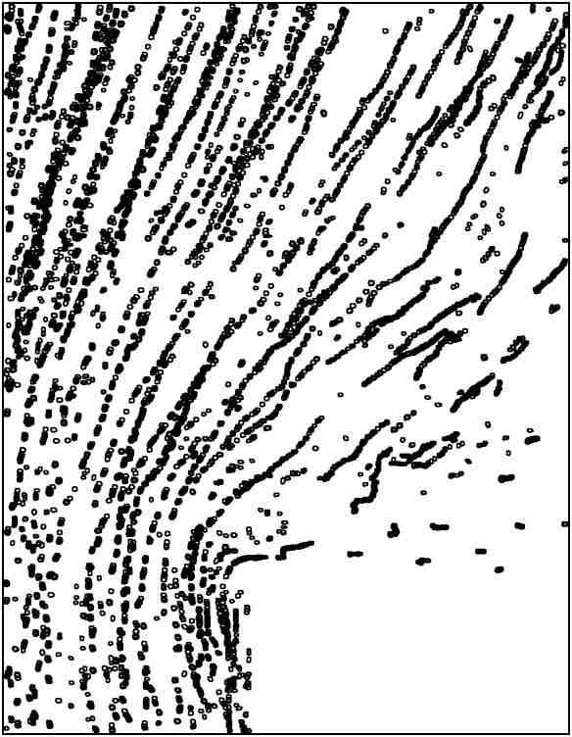
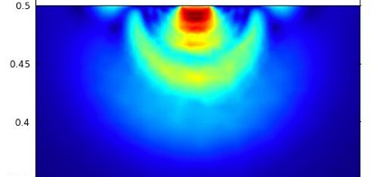
Boundary wear induced by concentrated suspension flow
Very concentrated suspensions of
solids, such as sand slurries or cement,
flowing through pipes cause the walls to wear. This process can be useful in
polishing or damaging in pipelines.
(2)
(1)
Controlled flows of particles in viscous fluids at
very high particle loading are studied in experiments
illustrated schematically in (1), with an image of
very hard material (glass beads at 58% solids) flowing
through a contraction in (2). The particle tracks from
this flow are analyzed (3) and used to determine the flow.
(3)
At length scales much smaller than a
bead pushed toward the wall by its neighbors,
intense stress is intense damages the surface,
as illustrated in (4): the central red zone is about
2% of the diameter of the bead.
(4)

