Slide 1
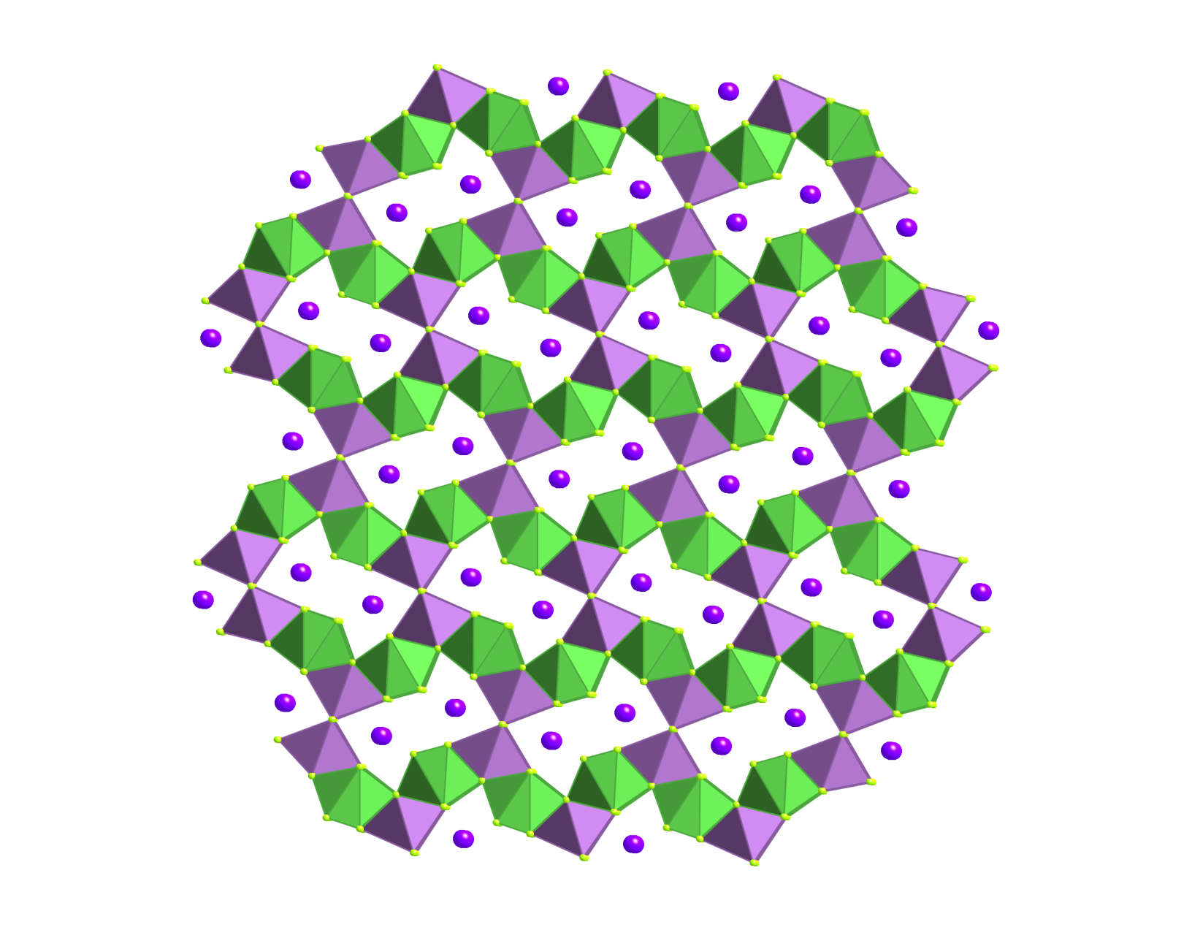
Synthesis of Novel Chalcogenide Materials Using Molten Flux Methods to Discover Potential Thermoelectric Materials
Benny C Chan, Chemistry Department, The College of New Jersey, Ewing, NJ 08628
Chalcogenides have numerous applications including optoelectronics, catalysis, magnetism, and thermoelectrics. Our research studies synthetic strategies to prepare novel chalcogenides. We have based our compounds on the well known bismuth tellurides and selenide compounds. Our general hypothesis is that the disruption of the rock salt-like structures of bismuth chalcogenides will improve the thermoelectric properties. The hypothesis was demonstrated in the literature through Kantazidis’ compounds in the Cs-Bi-Te composition space. We have furthered the disruption of the structure by adding a rare earth element that has a higher coordination environment than Bi but lower than Cs or K. The reaction was accomplished by reacting K₂Se₂ with La, Bi, and additional Se at 750 C.
 | K₂La₂Bi₂Se₉
a, ang | 11.546(3)
b, ang | 17.776(5)
c, ang | 4.3020(12)
α, β, γ | 90, 90, 90
Space group | P_{bam}
R factor | 0.0285
The structure consists of wave-like slabs of Bi (purple) and La (green) polyhedra. The potassium ions (purple spheres) sit inside of the channels made by the slabs.
We performed XPS to study the oxidation states, curiously, we have discovered the Bi is in multiple oxidation states, +3 (55.6%) and +5 (44.4%). The crystallography is modeled as a +3 oxidation state. We are continuing our study of the structure by doing bond valence calculations and additional magnetic studies to confirm the mixed oxidation states.

