Slide 1
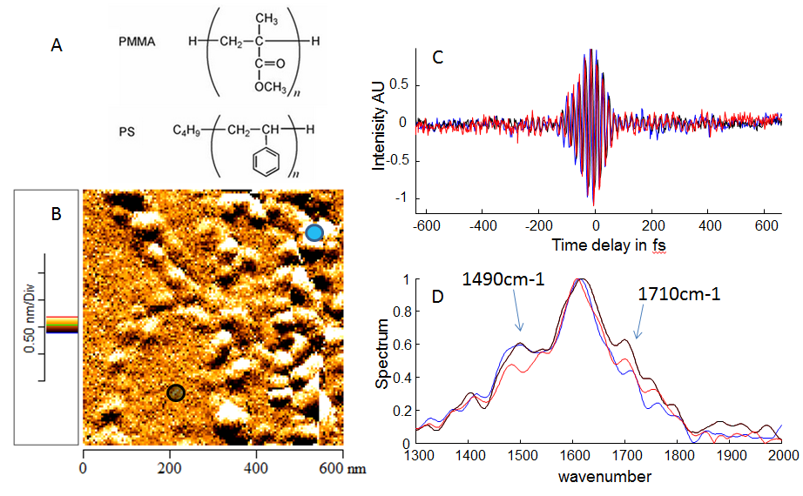
Ultrahigh spatial resolution infrared spectroscopic imaging of the phase behavior of block-copolymer nanostructures
Markus B. Raschke, Department of Physics, Department of Chemistry, and JILA,
University of Colorado, Boulder, CO
We have developed scattering-scanning near-field optical microscopy to allow for mid-IR Fourier-transform vibrational spectroscopic imaging using broad-band femtosecond IR radiation. This allows for the spectroscopic characterization of block-copolymer domains with 10’s nm spatial resolution.

