Slide 1
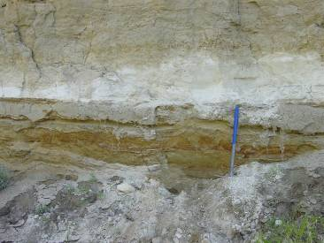
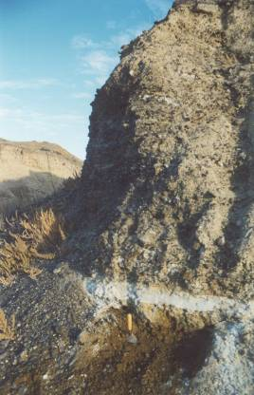
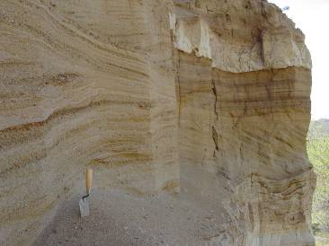
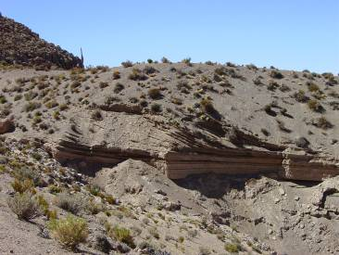
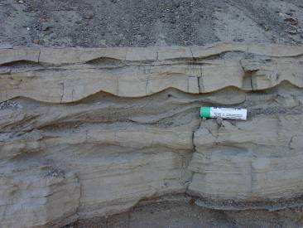
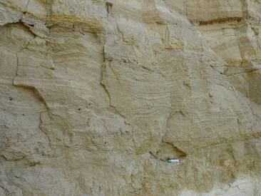
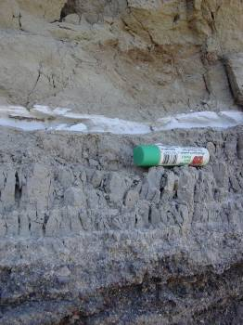
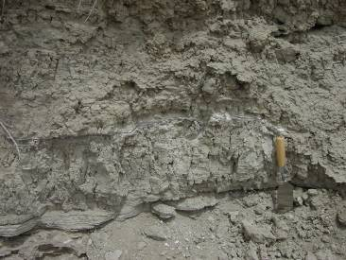
Depositional Model for Large, Clastic-Dominated Lakes
Squaw Creek
Bunejug Mts
Squaw Creek
Beach/
delta
Trego, 1258 m
Delta topsets
Gravel beach
deposits
Sandy beach
deposits
Wono, ~1204 m
(Non-linear scale)
Wave ripples
Delta foresets grading
into bottomsets
Near
shore
Hummocky
cross-stratification
Water Depth
Wave
Base
Smoke Creek
Horizontally laminated to thinly
bedded clay and silty clay with
ostracode partings
Off
shore
Trego, -40 m
Winnemucca Lake
Faint, thin bedding to massive clay with abundant post-depositional desiccation fractures
Trego, -90 m

