Slide 1
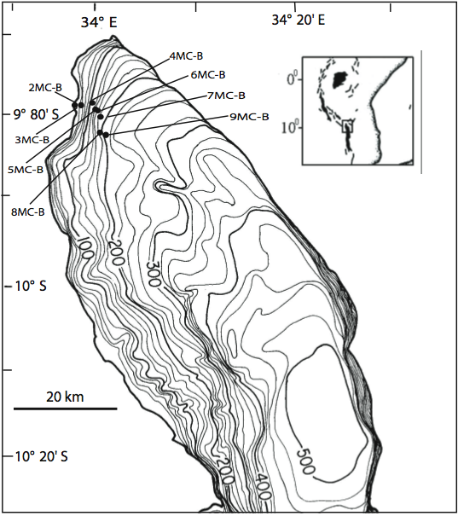
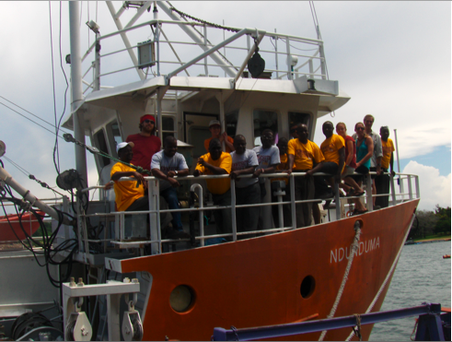
Characterizing Organic Matter in Sediments of a Tropical Rift Lake
PRF# 48595-AC2
PI: Thomas C. Johnson
Large Lakes Observatory
University of Minnesota Duluth
Notes:
Location of cores taken along a depth transect off the Songwe River delta in January 2009, with UMD students and Malawi crew aboard the R/V Ndunduma, operated by the Malawi Fisheries Department.

Slide 2
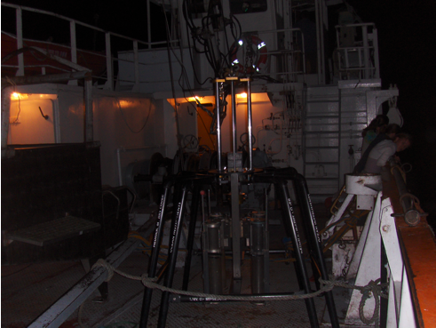
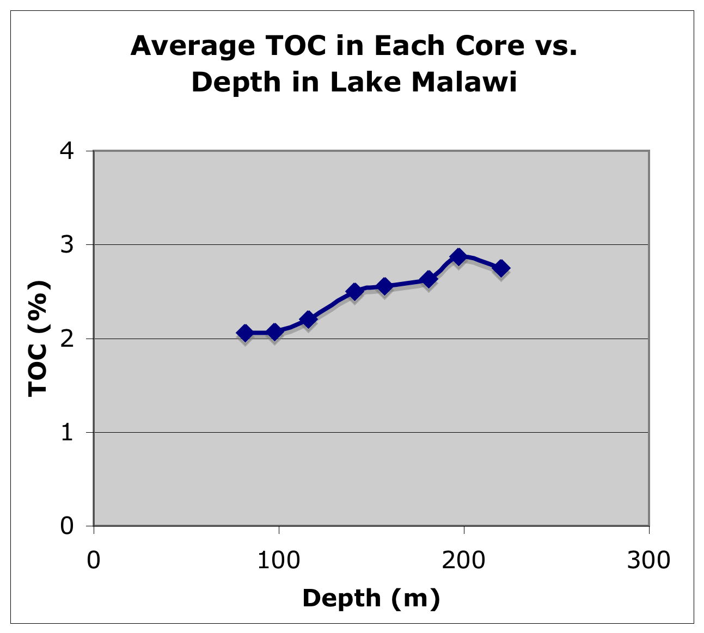
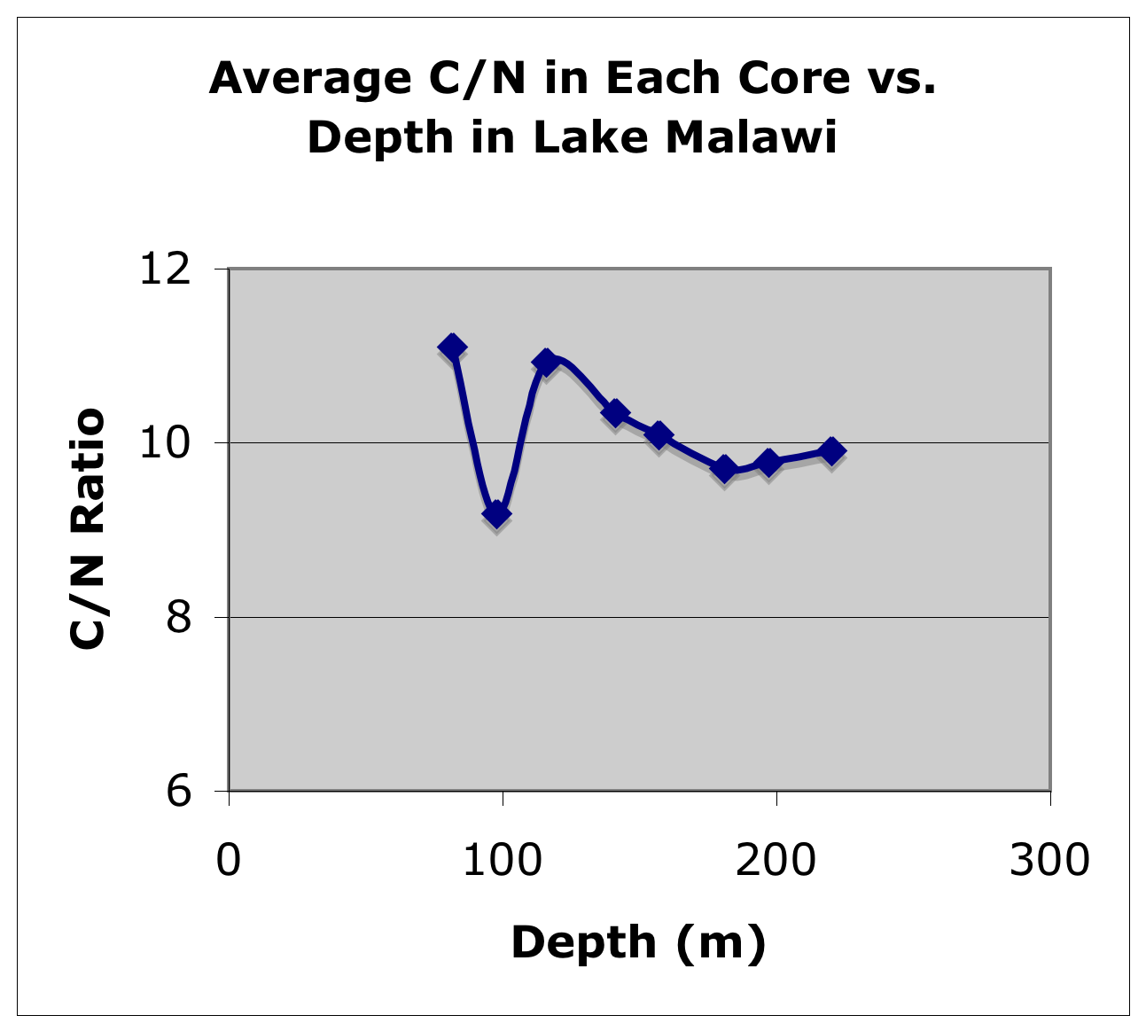
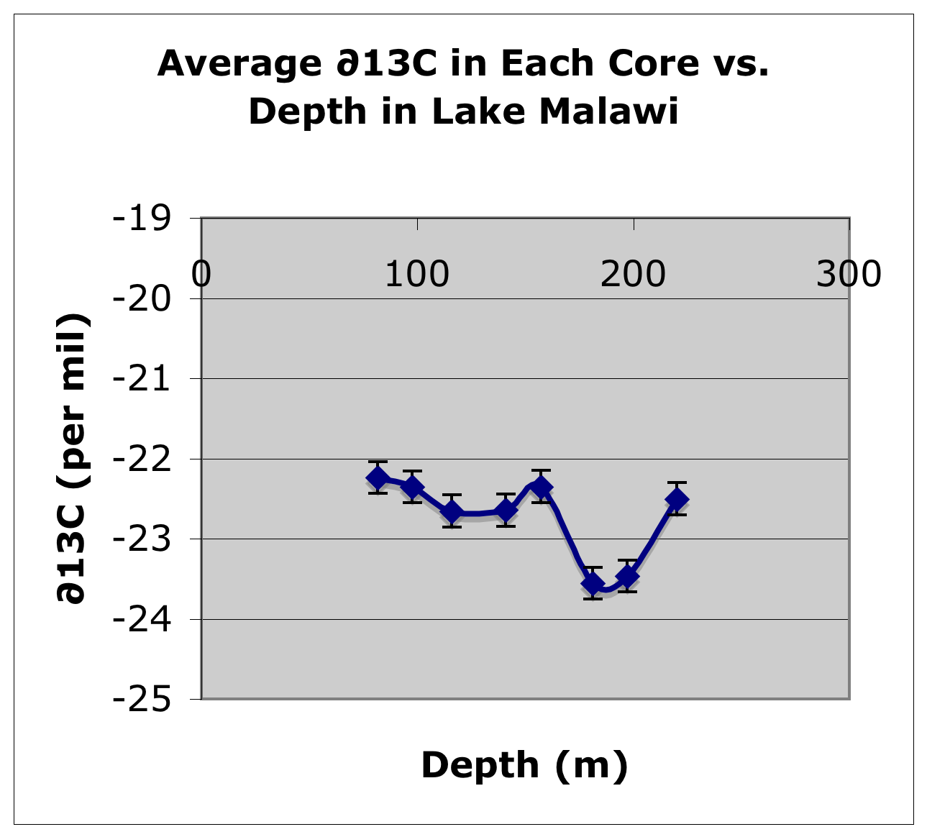
Notes:
Some results of bulk organic analyses completed by undergraduate student, Ryan Birkemeier, for his undergraduate research project. Photo shows the multi-corer that was used in the field program on the main deck of the R/V Ndunduma.

Slide 3
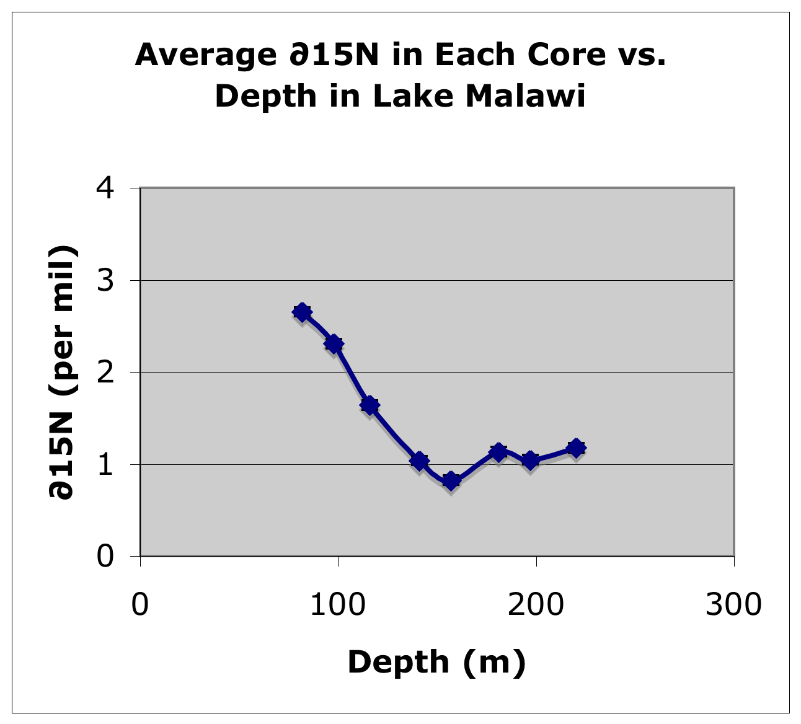
Notes:
Isotopic composition of the bulk organic matter shows intriguing shifts in composition near the depth of the chemocline (ca. 200 m), where the waters become anoxic. We are now moving on to the compound-specific analyses for ∂13C and ∂14C, to better discriminate between the terrigenous vs aquatic source of organic matter.

