Slide 1
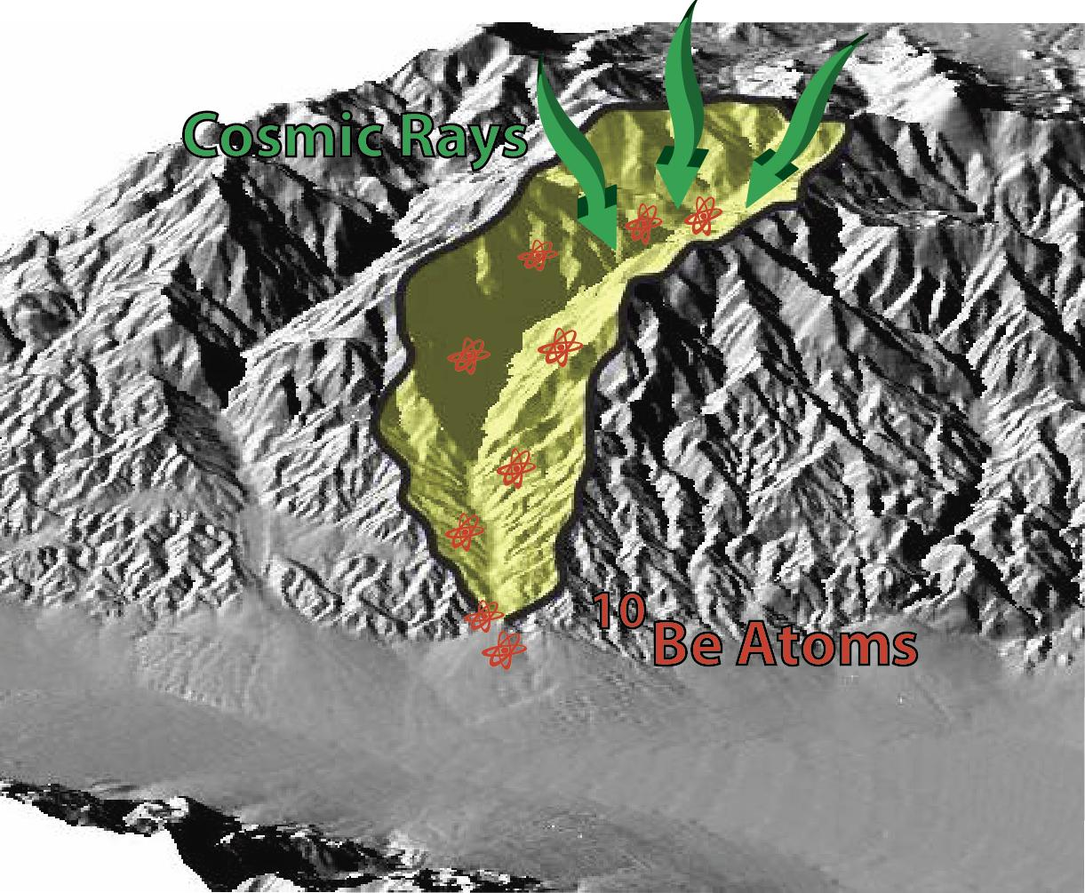
Investigating Source to Sink Processes with Cosmogenic Nuclide Concentrations in Multiple Alluvial Grain Size Fractions Kurt L. Frankel, School of Earth and Atmospheric Sciences, Georgia Tech
We are measuring cosmogenic ¹⁰Be concentrations in multiple alluvial grain size fractions to investigate processes of sediment erosion, transport and deposition
Our initial results show similar ¹⁰Be concentrations between different grain size splits from individual samples, suggesting that denudation processes are similar for a wide variety of alluvial grain sizes in tectonically active, arid regions

