Slide 1
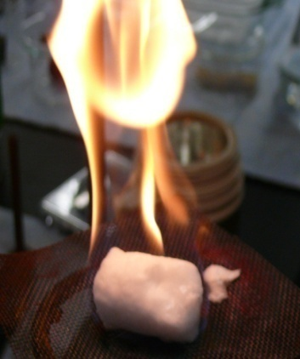
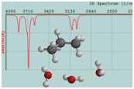
Interactions Between Small Hydrocarbons and Water:
Clathrate Formation and Inhibition
Mary Jane Shultz, Tufts University PRF 46671-AC6
Clathrates contain more carbon than all the oil so far identified on Earth. Generally oil or hydrocarbons do not mix well with water: in clathrates there is about 10,000 times as much hydrocarbon as normally found in water. Our objective is to understand how this vast hydrocarbon-water reservoir is formed. To probe the interactions responsible for cluster nucleation, propane clathrates were formed in an optical cell capable of withstanding 100 atm. pressure. Clathrates are stable on the bench top for short periods. Inclusion of the propane guest is shown by popping sounds as the gas is released and by the flame, photographed on the left, as the gas is burned.
Illustration of propane inside a cage of water molecules: each vertex represents a water molecule the large black spheres represent carbon and the smaller, light spheres represent hydrogen in the propane molecule.
Fundamental interactions leading to clathrate formation are probed by dispersing water, propane, and inhibitors in carbon tetrachloride and using infrared spectroscopy. (Dispersion avoids the opacity of aqueous solutions.)
Burning clathrate on the laboratory bench in our laboratory.
Absorbance
CH₃CD₂CH₃:
methyl groups
unaltered by water
Infrared spectroscopy effectively probes the initial interaction between the first few water molecules and the propane guest molecule: water interacts the methylene hydrogen atoms. The experimental evidence is a splitting of the CH₂ group resonances, with a blue-shifted resonance emerging(shown on the left). Modeling results support a picture of a string of water molecules along the propane, shown schematically on the right.
Wavenumber (cm⁻¹)
CH₃CD₂CH₃:
methylene groups
split and blue shifted
by water
Absorbance
Wavenumber (cm⁻¹)
http://chem.tufts.edu/faculty/shultz/index.html

