Slide 1
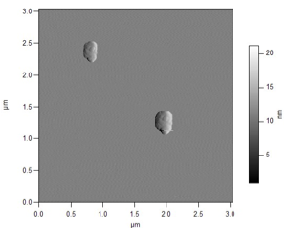
Investigation of Rolling and Sliding Nanometer Scale Objects
W. Garrett Matthews, Department of Physics, University of South Florida
This work seeks to discover how the method by which sustained translations of nanoscale particles across their abutting surfaces is determined by their material properties – can we predict whether a given particle will slide or roll? We are testing the hypothesis that the linear dimensions, interfacial surface energy, and elasticity determine the tendency to slide versus roll when lateral forces are applied to nanoscale spherical objects. The interplay between these properties determines the transition point where a rolling mode of translocation (preferred for macroscopic objects) changes to a sliding mode. It is this transition point as a function of the stated variables that we seek to map and model.
We are using lateral force microscopy to measure the force required to translate asymmetric, nanoscale particles of controlled size, surface chemistry, and moduli. The force traces recorded are being analyzed for periodic features that can be correlated to the surface topography of the particles as a test for rolling.
Rolling or Sliding?

