Slide 1

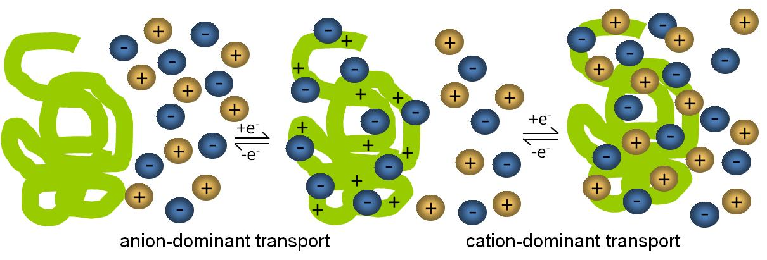
Ionic Liquid Mobility in Electroactive Polymers
Jennifer A. Irvin, Department of Chemistry & Biochemistry, Texas State University, San Marcos, TX 78666
Ionic liquid electrolytes significantly enhance stability and performance of electroactive polymer-based devices, but little is known about how ionic liquids move in and out of electroactive polymers. The ion transport processes in electroactive polymers play an important role in morphology, stability, and electrochemical properties.
Effect of Changing Electrolyte on Electroactivity
For p-doping in PEDOT:
Anion-dominant in 0.1M EMIBTI/CH₃CN
Cation-dominant in neat EMIBTI
When PEDOT grown in 0.1M EMIBTI/CH₃CN is cycled in neat EMIBTI, PEDOT no longer oxidizes/reduces effectively

