Slide 1
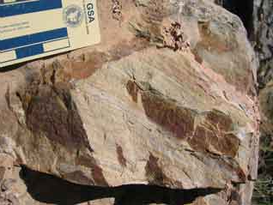
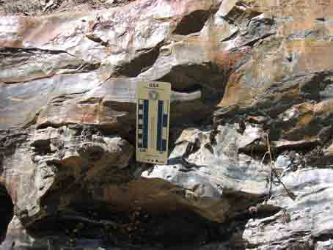
Age and provenance of clastic sediments from the nonmarine Goldstein Peak unit
Diane Clemens-Knott, Department of Geological Sciences, California State University, Fullerton, Fullerton, CA 92834
We have analyzed ≈100 zircons from each of 6 samples of the recently discovered Goldstein Peak (GP) formation within the Lake Kaweah pendant of the western Sierra Nevada batholith. These data confirm the GP’s Early Cretaceous depositional age and suggest a dominantly arc provenance, consistent with the study’s hypothesis that fluvial GP protoliths carried arc detritus into California’s Great Valley forearc basin.
Mike Martin’s preliminary detrital zircon data from the Goldstein Peak formation, Lake Kaweah pendant
This year, CSUF undergraduate Kevin Tomita and I discovered a second probable occurrence of Cretaceous metasediments, 65 km SE of the Lake Kaweah pendant.
The detrital zircon samples are dominated by ages consistent with derivation from the Jr-Tr Sierran arc.
undeformed bedding in E. Cretaceous(?) on-lap
Lesser amounts of older zircons (1) will support a provenance analysis for the river sediments, and (2) may support a correlation with detrital zircon populations in California’s oil-rich Great Valley Sequence.
E. Cretaceous(?) on-lap
Future detrital zircon work will target newly discovered, weakly metamorphosed and undeformed siliciclastic metasediments in a nearby pendant that also are in depositional contact with the JuroTriassic Kings Sequence. Inclusion of this new locality should expand our reconstruction of the Cretaceous Sierran onlap sequence and possibly the earliest stages of Great Valley sedimentary system.
Tr-Jr Kings Sequence

