Slide 1
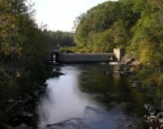
Dam-controlled river deltas as meso-scale analogues for
offshore sedimentary systems
Noah P. Snyder (noah.snyder@bc.edu)
Department of Geology and Geophysics, Boston College, Chestnut Hill, MA 02467
We use lidar elevation surveys and radiocarbon dating to quantify the amount of modern floodplain sediment upstream of a dam breached for fish passage in the mid-1950s.
This research supports the hypothesis that breached dams maintain impounded sediment in the system and create new fluvial interactions by impacting the form and function of upstream floodplains decades to centuries after breaching. Understanding the long-term impacts of dams on river morphology contributes to estimations of pre-dam environments, and aids restoration work.
Figures (right) illustrate the location of Head Tide Dam in mid-coast Maine, the approximate extent of the pre-breached millpond (estimated from lidar), and the incised modern channel. From radiocarbon (wood) analyses, the exposed floodplain stratigraphy for ~3 km upstream is composed of at least 2 m of fine-grained millpond sediment, present and fluvially active 60 years after the dam was breached.
1 m
1845 C.E.
1600 C.E.
1770 C.E.
In the figure above, the yellow circle indicates the location of the stratigraphic column to the left. On the stratigraphic column, the red circles indicate the location of radiocarbon samples, with the corresponding age to the right.

