Slide 1
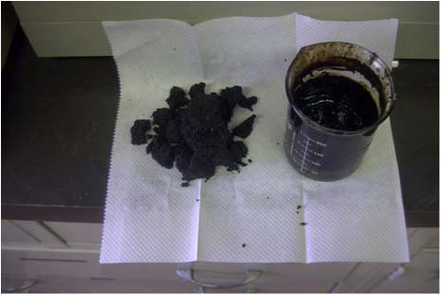
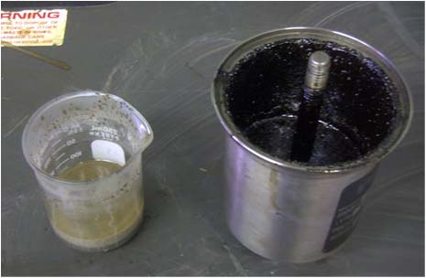
Extraction of Bitumen from Oil Sands
HOSE
Oil sand samples (12 % bitumen by wt.) of Asphalt Ridge, Utah (left in picture) and collected bitumen (right in pic.).
Depleted, settled oil sands (left in pic.) and collected bitumen via pressure cycles (right in pic.).
Extraction conditions: T = 85 ºC; P = 100 psi; 20 cycles; total extraction time: 10 min.

