Slide 1
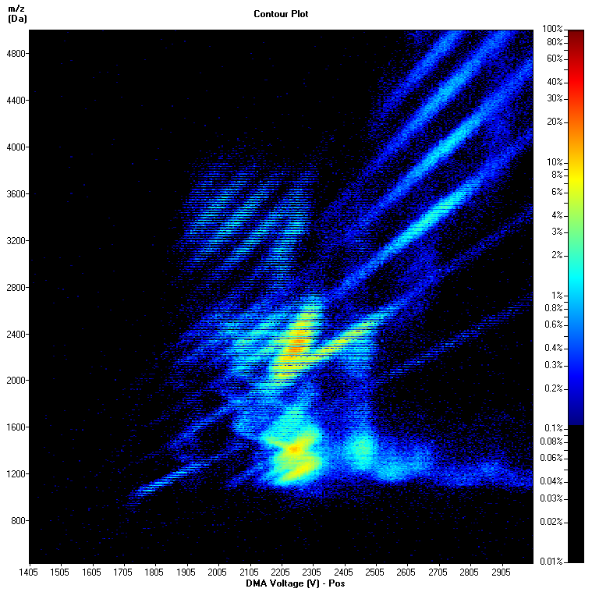
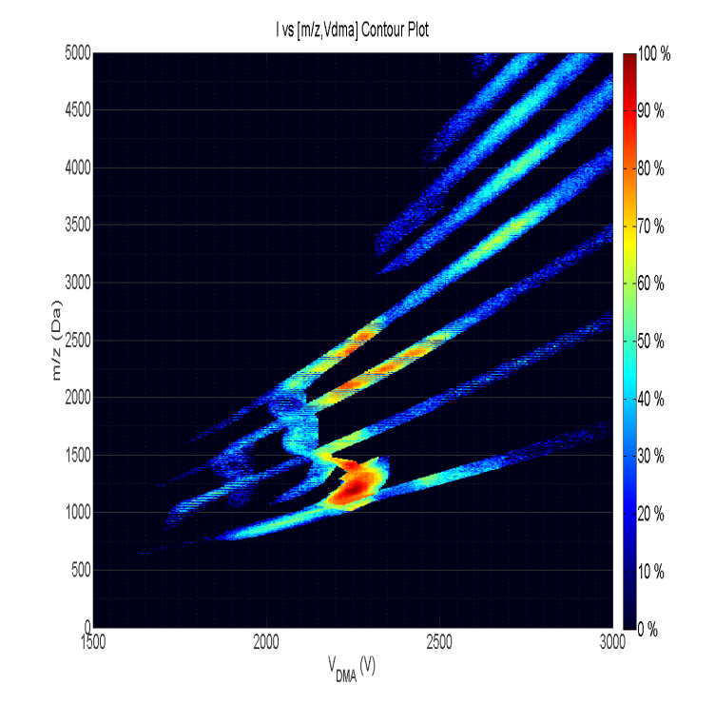
1. The possibility of injecting ions and nanodrops from electrified ionic liquid surfaces into dielectric liquids has been demonstrated 2. Analysis of polymers by ion mobility spectrometry/mass spectrometry (IMS/MS) has been achieved with excellent separation. Spectra shown in the figure are for polyethylene glycol. The horizontal variable is proportional to inverse mobility, the vertical variable is m/z, and the logarithmic color scale gives ion abundance. The charge reducing buffer is triethylammonium formate. The left figure shows complicating charge loss transitions arising at the MS entrance, corrected on the right figure. Important mechanistc information on electrospray charging is contained in these data.

