Slide 1
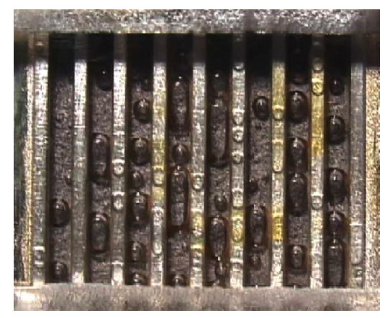
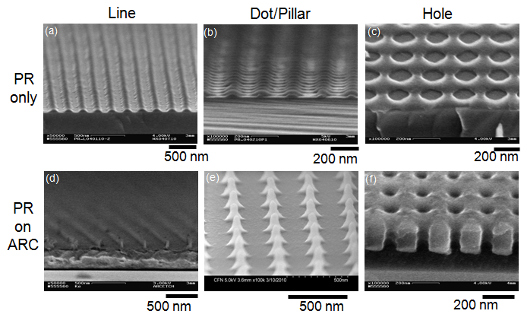
Bubble Detachment on Micro/Nano Structured Solid Surfaces
in Energy Applications
Sung Kwon Cho, University of Pittsburgh
Chang-Hwan Choi, Stevens Institute of Technology
Motivation:
Detachment/removal of bubbles are critical process in many energy applications
Key idea:
Nanostructured surfaces will significantly reduce the adhesion between the bubbles and surface
Water
Gas bubble
Low adhesion
Fuel Cells
Boiling
Method/Achievement:
Using interference lithography, well defined arrays of nanostructures are fabricated.

