Slide 1
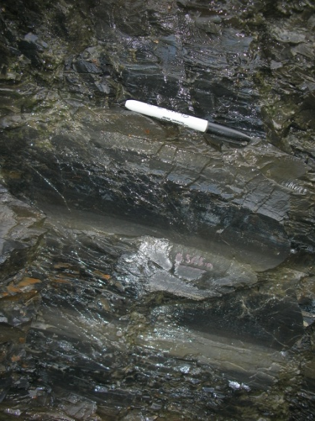
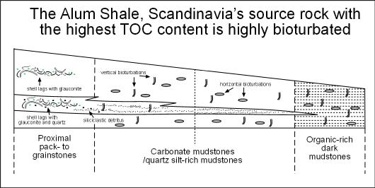
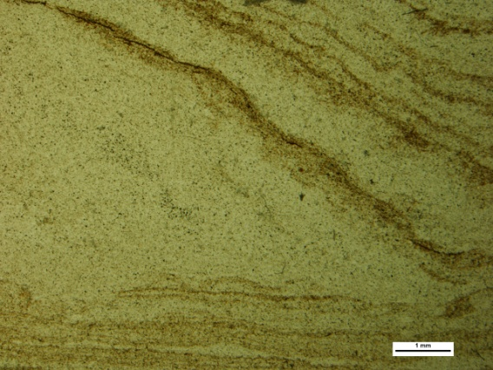
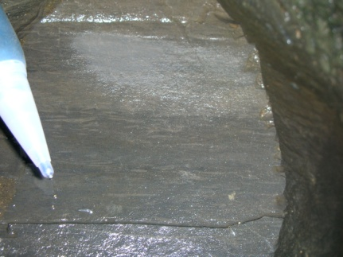
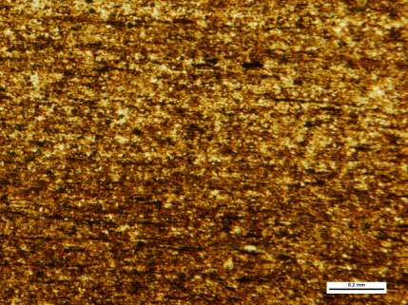
Deposition on the far end –
shale facies architecture as an archive for high-frequency cyclicity
Sven Egenhoff, Department of Geosciences, Colorado State University
The Alum and Tøyen Shale depositional systems of Scandinavia…
… preserve small-scale,
possible Milankovitch-type (?) cyclicity
This environment was
not anoxic
tectonically active
during sedimentation
likely shows climatic
control on deposition
… contain slumps indicating
synsedimentary tectonic activity
… show horizontal
bioturbation
… show vertical
bioturbation

