Slide 1
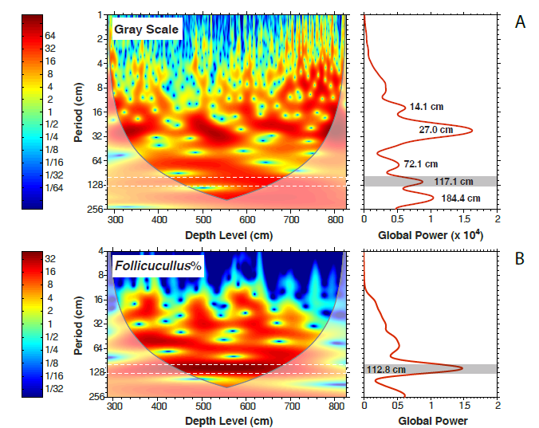
Use of Geochemical Proxies to Evaluate Paleosalinity and Carbon Flux in the Bell Canyon Formation, Guadalupe Mountains West Texas
Paula J. Noble, Department of Geological Sciences and Engineering, University of Nevada Reno
High terrestrial
Low terrestrial
spumellarian
blooms
Fluctuations in fossil zooplankton distribution, when analyzed below with power spectra, show a regular frequency of reoccurrence. These fluctuations may represent an ancient climate signal between wetter and drier times.
Follicucullus
dominated
Examination of specific organic compounds called biomarkers work as fingerprints for the source of organic matter in ancient rocks. The above plot shows changes in the Permian Bell Canyon Formation, deposited in the Delaware basin of west Texas. Biomarkers indicate that this ancient ocean basin was periodically fertilized by land derived nutrients creating massive blooms of a type of fossil zooplankton called spumellarians.

