Slide 1
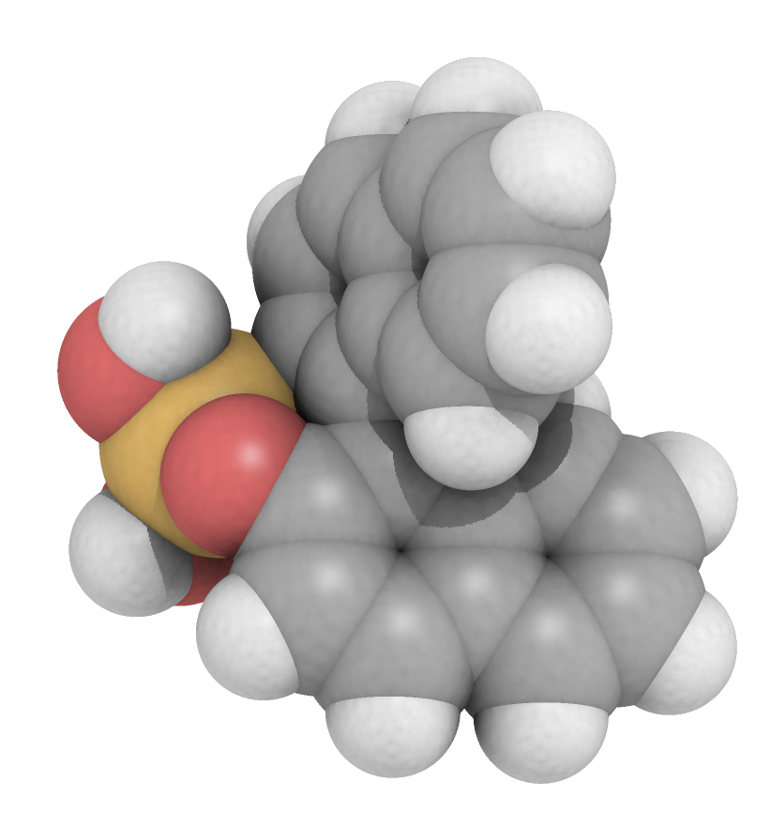
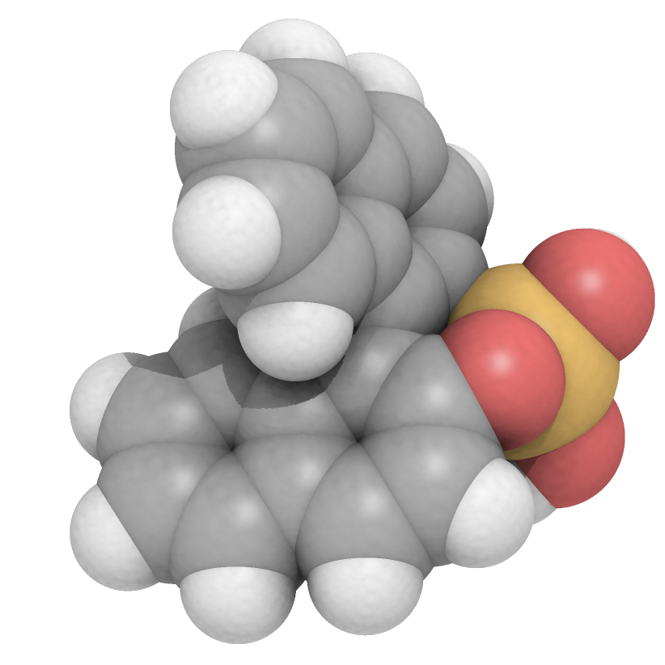
Cholate
Diffusion NMR probes how bile micelles differentially solubilize enantiomers of BNDHP
Deoxycholate
Significant hydrodynamic differentiation between cholate interacting with R- and S-BNDHP, shows best distinction with small aggregates.
Weaker hydrodynamic differentiation between deoxycholate interacting with R- and S-BNDHP, in part because larger aggregates are formed
S-BNDHP interacts more strongly with the bile micelles. Both bile micelles exhibit loss of chiral selection with increasing concentration.
Cholate (Ch)
Deoxycholate (DC)
Difference in effective radii { (Ch + BNDHP) - (Ch)}
Difference in effective radii {(DC + BNDHP) – (DC)}
Distance (Å)
Cholate Concentration (mM)
Deoxycholate Concentration (mM)

