Slide 1
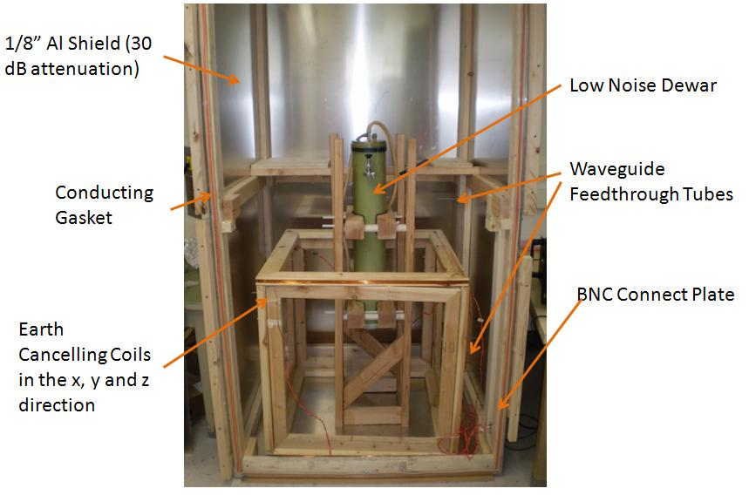
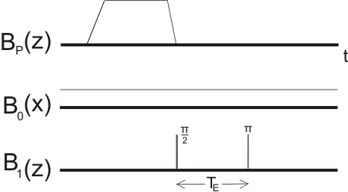
Nuclear Spin Relaxation and Restricted
Diffusion in Microtesla Magnetic Fields
Robert McDermott, UW-Madison
Scanner
Experimental Setup
NMR Pulse Sequence
SQUID Probe
We have constructed a low-field NMR scanner based on a dc SQUID. The SQUID detector is operated with a tuned 1st-order gradiometric pickup coil, and is housed in a home-made low-noise liquid helium cryostat. The sample is maintained at room temperature, with a small separation ~ 1 cm from sample to the pickup loop of the detector. The entire experiment is housed within a 4’x4’x8’ eddy current shield made from 1/8” aluminum for RF and magnetic shielding. Pairs of coils cancel the Earth’s magnetic field in the y and z directions, and provide a weak static field in the x direction. The magnetic field noise of the system is 3 fT/sqrt(Hz) at the 4.8 kHz detection frequency. To enhance signal-to-noise ratio, the spins are prepolarized in a strong transient field of order 100 mT. Adiabatic removal of this field causes the spins to reorient along the weak measurement field, and resonant audiofrequency pulses induce spin precession and form spin echoes. We will soon undertake a series of pulsed gradient spin echo experiments to probe relaxation times and restricted diffusion in porous media.

