Slide 1
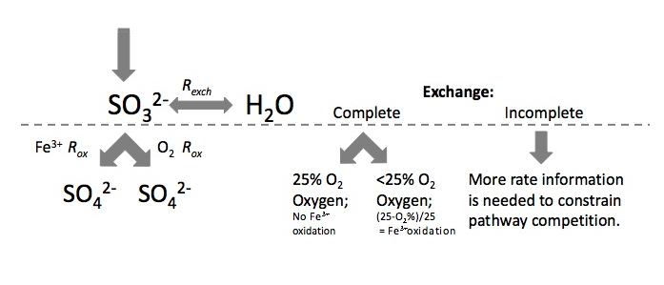
Experimental Sulfate Triple-Oxygen Isotope Geochemistry
Huiming Bao

