Slide 1
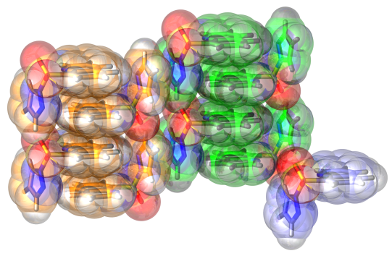
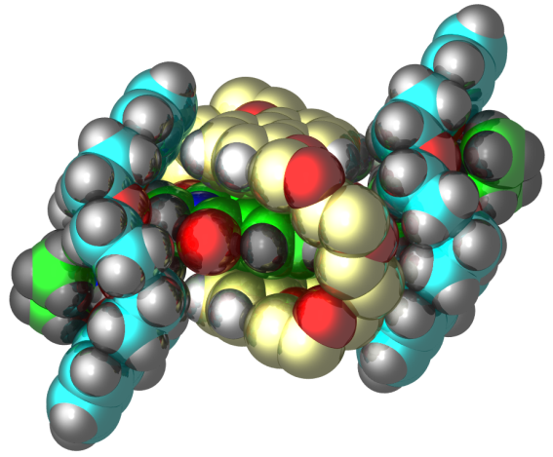
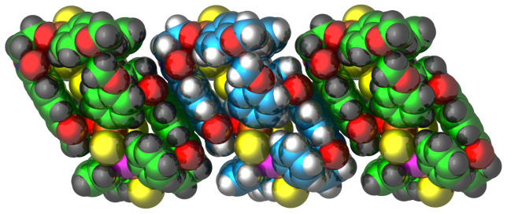
Novel Organic-Inorganic Hybrid Cage Architectures
Radu F. Semeniuc, Department of Chemistry, Eastern Illinois University
The synthesis of hybrid organic-inorganic architectures witnessed an increased interest during the last
decade, due to their potential applications as gas storage, separation and purification materials, as well as heterogeneous catalysts.
We used a supramolecular approach toward the synthesis of these compounds, making use of a
combination of covalent (ligand – metal donor) bonds and non-covalent interactions (hydrogen bonding and π-π stacking interactions).
We were successful in preparing new metal containing macrocyclic compounds that in solid state self-
assemble in chains, sheets or 3D complex networks. Further, using the interplay between hydrogen
bonding and π-π stacking interactions we were also able to prepare a representative of a rare class of
compounds, a [4]pseudorotaxane containing different crown ethers threaded by one axle having different recognition sites.
These compounds are the starting point toward more complex hybrid architectures.

