Slide 1
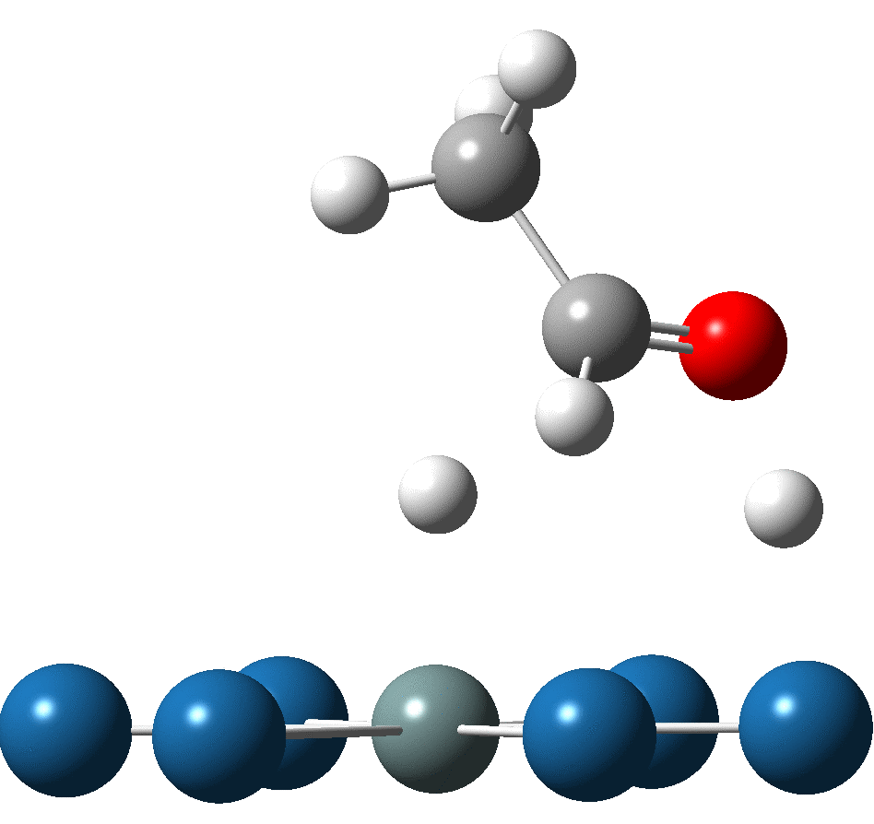
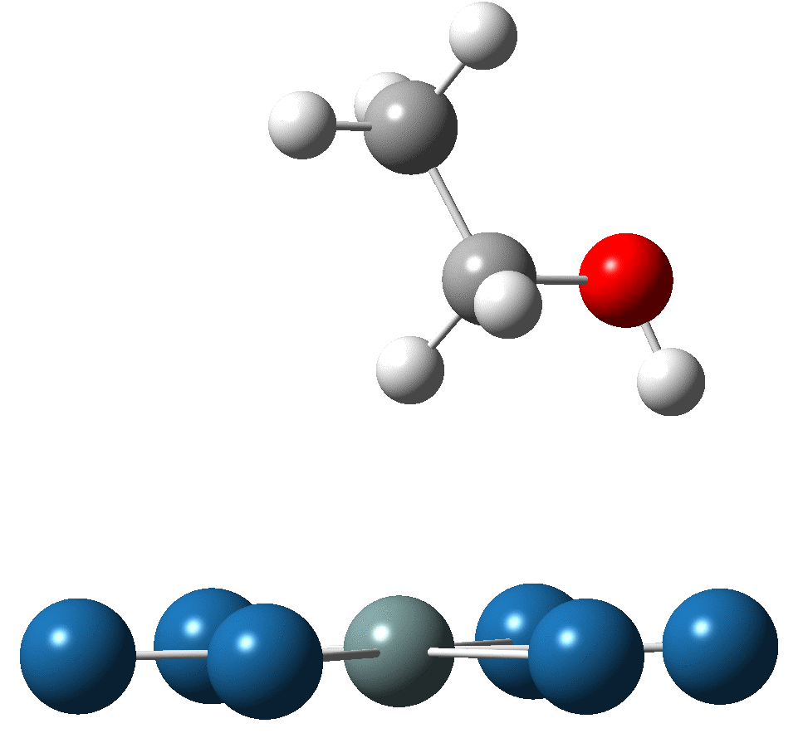
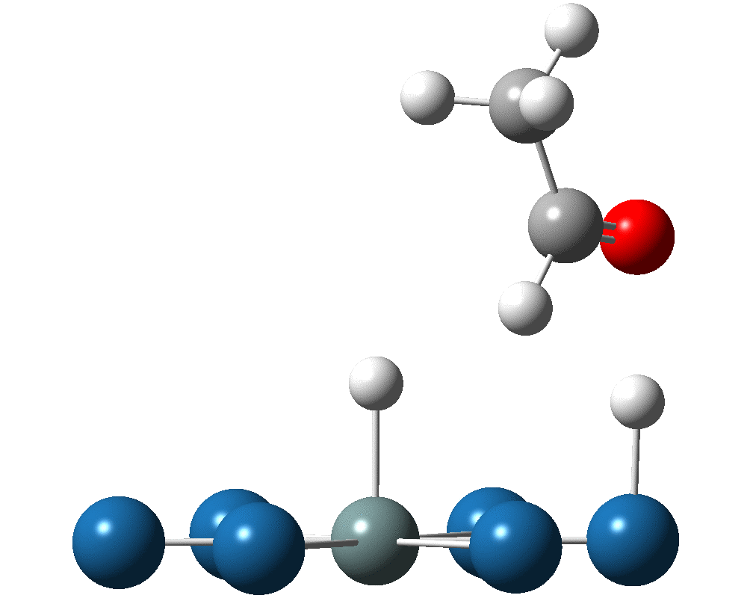
On the activation mechanism of Sn to the EER of ethanol: decomposition of H₂O and ethanol over PtnM clusters Yixuan Wang, Albany State University, Albany, GA 31705
The fundamental assumption of the bi-functional mechanism for PtSn alloy to catalyze ethanol electro-oxidation reaction is that Sn facilitates the dissociation of H₂O and Pt site catalyzes ethanol decomposition. Our investigation is to clarify this assumption and get detailed information about decomposition mechanism of H₂O and CH₃CH₂OH.
The adsorptions and subsequent decompositions of ethanol via hydroxyl as well as α-H on PtM have been investigated. It is interesting to note that on the clusters Pt₇ and Pt₆Ru the decompositions via α-H have lower energy barrier than those via hydroxyl, while on the cluster Pt₆Sn oppositely α-H decomposition has higher barrier than hydroxyl. The results indicate whether ethanol decomposition proceeds initially via O-H or α-CH bond cleavage may depend on the type of catalysts. Moreover, it is found that the adsorption via α-hydrogen actually results in a concerted decomposition for the hydroxyl and α-C-H. The favorable decomposition pathway, via α-hydrogen on Pt₇ has lower activation energy by 0.17eV than the path via hydroxyl on Pt₇Sn, and thermodynamically the former is also favorable than the latter ( dissociation energy: 0.35 vs -1.25eV). Thus, Pt is more active to ethanol oxidation reaction than Sn in terms of thermodynamics as well as kinetics.
Dissociative adsorptions for hydroxyl and α-H of ethanol over Pt-based bimetallic: A concerted pathway
Together with the investigation of H₂O adsorption on Pt_{n}M, the present results support the proposed bifunctional mechanism for PtSn alloy to catalyze ethanol electro-oxidation reaction that the dissociative adsorption of ethanol occurs on platinum sites and Sn primarily promotes adsorption and dissociation of water to form OH oxidizing intermediates from ethanol.

