Slide 1
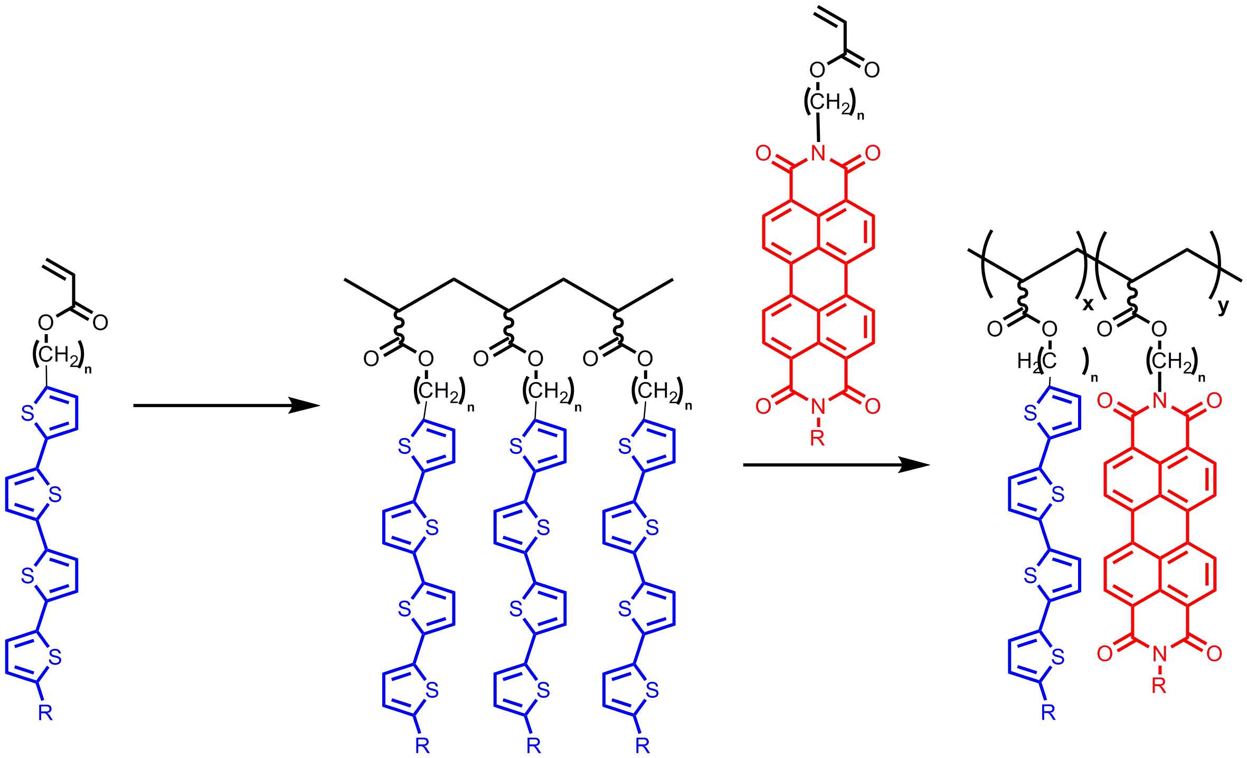
Development of Stereoregular Electroactive Block Copolymers for the Supramolecular Assembly of Organic Photovoltaics
Barry C. Thompson, Department of Chemistry, University of Southern California, Los Angeles, CA 90089-1661
Segments of conceptual stereoregular π-pendant polymers.
Isotactic
Proposed role of Lewis Acids in controlling stereochemistry in radical polymerizations.
Syndiotactic
Donor-Acceptor Stereoregular Block Copolymers for Organic Photovoltaics
Model Systems Investigated

