Slide 1


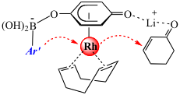
Catalyst design and development: Exploration of a new class of Rhodium(I) catalysts
William C. Trenkle, Department of Chemistry, Brown University
The formation of carbon-carbon bonds is a critical operation in the assembly of molecules. Numerous groups are engaged in the development of new, or improved, procedures for this purpose. Organometallic catalysis allows for the discovery and elucidation of new reaction pathways to accomplish the overarching goal of bond formation. Our group is motivated by the thesis that these limits can be overcome with a new class of multifunctional rhodium(I) and iridium(I) quinonoid catalysts. Remarkable features of the rhodium catalyst system includes tolerance of extremely electron deficient aryl boronates (including the first example of trihalogenated substrates) as well as ability to catalyze the formation of quaternary carbon centers through addition to beta,beta-disubstituted conjugate acceptors.

