Slide 1
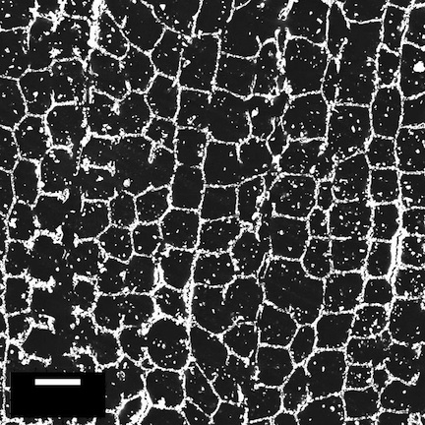
Synthesis of Novel Oxynitride Structures by Soft Chemical Routes
Neal M. Abrams
SUNY College of Environmental Science and Forestry, Syracuse, NY 13210
The efficient capture and conversion of solar energy requires a photocatalyst with a small bandgap able to absorb visible wavelengths. Oxynitrides offer advantages of being relatively stable and eco-friendly materials. Compared to binary nitrides, rare-earth metal oxynitrides are air stable, similar to their oxide counterpart. Because of this increased stability, the physical and chemical characteristics can be exploited under ambient conditions.
Oxynitride synthesized by traditional (lower) and solvothermal (upper) pathways.
We are developing toolbox of synthetic solvothermal routes to oxynitrides materials. An impetus for this research is that oxynitrides show improved photocatalytic efficiency compared to the oxide analogs. Building upon the principle, we are developing a methodology for using natural (cellulosic) materials as biomimetic templates for high-surface area oxynitrides.
20 μm

