Slide 1
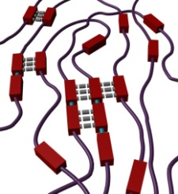
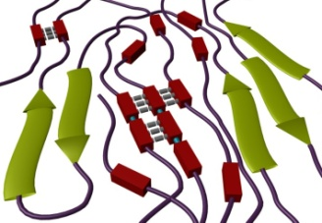
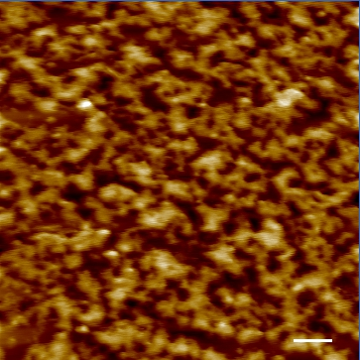
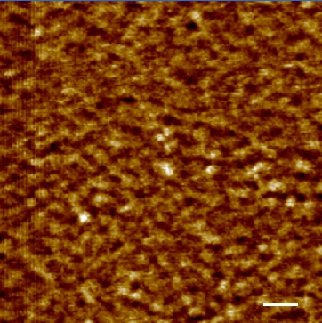
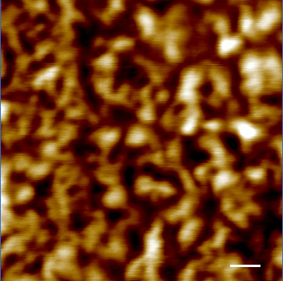
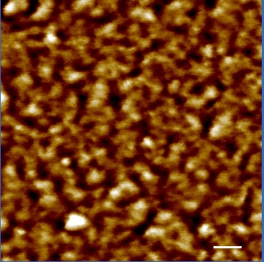
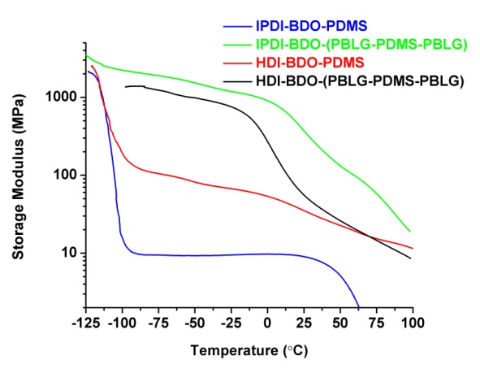
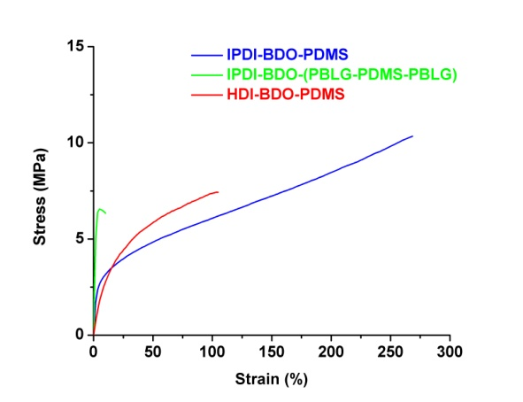
Hierarchically Designed Segmented Polyurethanes for High Performance Applications
Goals
Develop nature inspired, novel polypeptide/polyurethane hybrid systems and explore the affects of hierarchical ordering on the thermal and mechanical properties.
Utilize this understanding to develop tough materials for scratch and/or impact resistant coatings
Segmented Polyurethanes (SPUs)
PUs are multi-block polymers usually consisting of an amorphous, flexible soft segment and a rigid crystalline or high T_{g} hard segment. The flexible segments form a continuous domain, which is anchored by physical crosslinking of the hard segment aggregates.
AFM of PUs demonstrating the phase separated nature of the polymers. Images are 1 µm x 1 µm. a) IPDI-BDO-PDMS, b) IPDI-BDO-(PBLG-PDMS-PBLG), c) HDI-BDO-PDMS, d) HDI-BDO-(PBLG-PDMS-PBLG)
Accomplishments
Design and synthesize novel hybrid polypeptide/polyurethanes containing:
Mechanical studies confirm additional ordering does increase mechanical properties
PBLG-b-PDMS-b-PBLG
Temperature depended storage modulus (right), higher modulus equals stiffer material, and tensile data (left) of PUs with and without polypeptide segments. Notice, the SPUs with polypeptides retains higher stiffness through a wider temperature range . The tensile modulus of the IPDI peptidic PU is nearly 4x greater than the non-peptidic PU.

