Slide 1
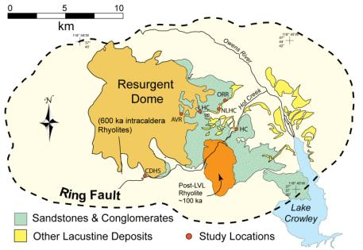
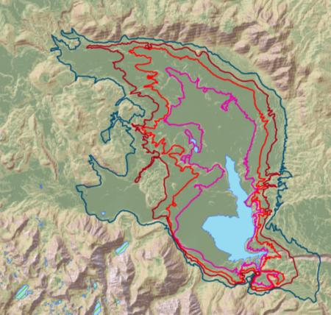
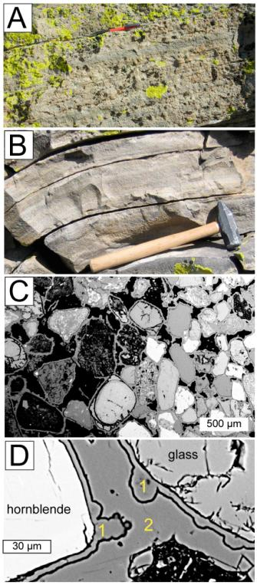
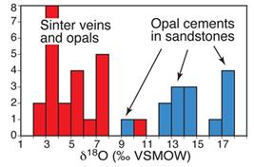
Sandstone Silicification in a Caldera Lake: Implications for Cementation at High Geothermal Gradients
1
Jade Star Lackey, Department of Geology, Pomona College, Claremont, CA.
4
2
Long Valley Lake: The supervolcanic eruption of the Bishop Tuff 760,000 years ago created the Long Valley (LV) caldera in east-central CA (1). A Pleistocene lake filled the caldera (2), and Sandstones deposited in the lake were cemented by siliceous geothermal fluids (3A,B).
Objective & Significance: In this study at LV, we seek to better understand the rates and modes of sediment cementation in geothermal and hydrocarbon reservoirs. Fortuitous exposure of the LV sandstones creates an ideal natural laboratory to study these processes.
GIS rendering of
possible Long Valley
Lake stands.
Outcomes: LV sandstones have complex cementation structures at cm to mm scales with multiple generations of cement showing step-wise sealing of the LV sandstones (3A-D). Oxygen isotopes of opal cements are high relative to geothermal silica sinter rocks (4) indicating that cements were deposed when hydrothermal fluid “outbursts” mixed with cool lake waters.
4
1 & 2 are cement bands

