Slide 1

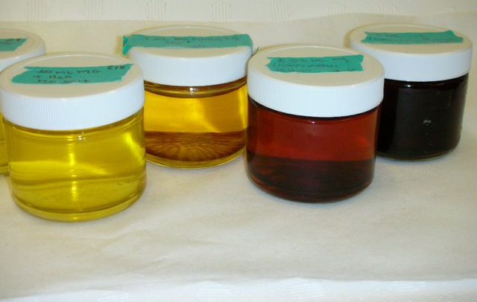
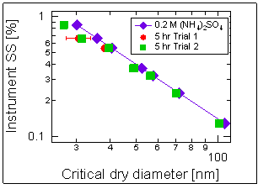


Sources and Chemistry of Organic Aerosol Material
V. Faye McNeill, Department of Chemical Engineering, Columbia University
Methylglyoxal (MG) and glyoxal (G), when absorbed into aqueous ammonium sulfate aerosols, oligomerize to form low-volatility Secondary Organic Aerosol Material (SOA). This process can increase aerosol mass and change other aerosol properties which are important for climate, including light absorption and surface tension.
G and MG form light-absorbing products in aqueous aerosol mimics
Surface tension depression leads to increased cloud droplet nucleation by small particles
Surface tension depression by MG and G-MG mixtures in aqueous aerosol mimic solutions
Sareen et al., Atmos. Chem. Phys. , 10, 997-1016 (2010)
Schwier et al., Environ. Sci. Technol. , 44(16) 6174-6182 (2010)

