Slide 1
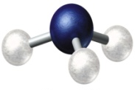
Energy Transfer in a Trapped Gas of NH Molecules Heather Lewandowski, JILA / Department of Physics, University of Colorado
The process of breaking one chemical bond and forming another is challenging to understand at a quantum mechanical level. This basic understanding is important to any molecular reaction. However, the complicated quantum nature of these processes is difficult to explore experimentally because full control over all degrees of freedom is required. We created a cold molecular system using Stark deceleration to study interactions while controlling both the internal and external degrees of freedom.
We are exploring the interactions of ultracold radical atoms with ammonia molecules at 30 mK. By trapping them inside our vacuum chamber we can achieve interaction times on the order of seconds, which is four orders of magnitude greater than typical molecular beam experiments. We are studying how collisions between the atoms and molecules are affected by externally applied electric fields.

