Slide 1
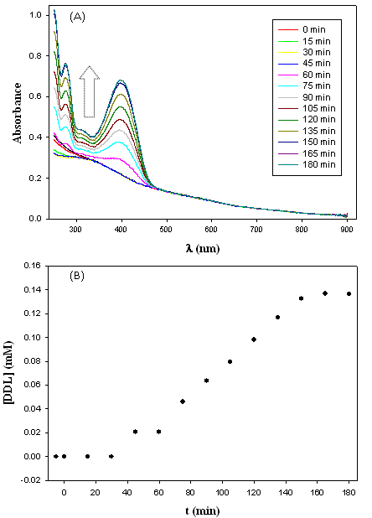
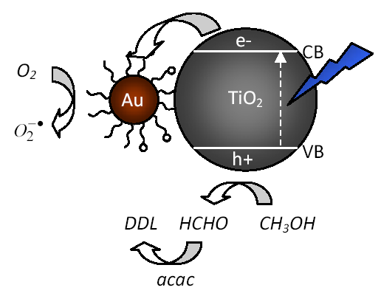
Nanoplasmonics-Based Photovoltaics
Shaowei Chen, Department of Chemistry and Biochemistry, University of California – Santa Cruz
Au-TiO₂ heterodimers for the photocatalytic oxidation of methanol into formaldehyde, as detected by the Nash method

