Slide 1
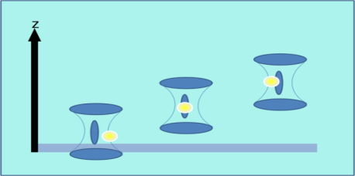
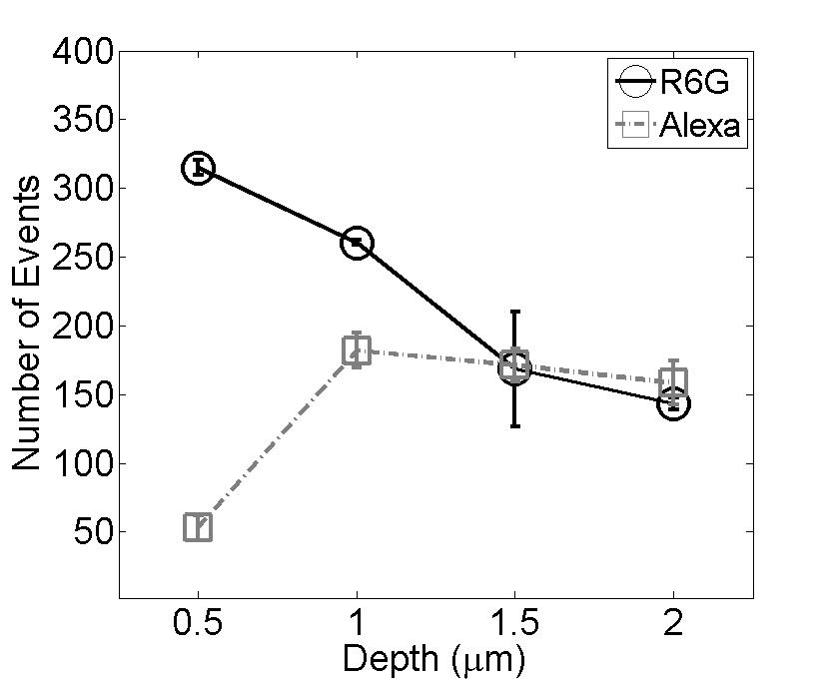
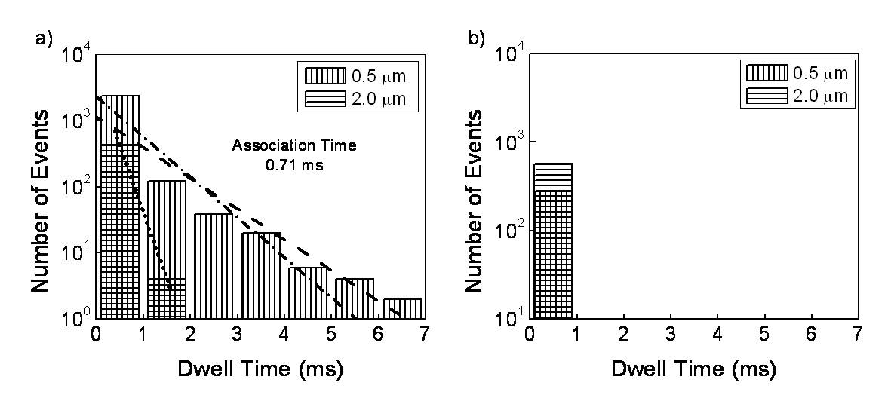
Transport in Supported Polyelectrolyte Membranes
Christy F Landes, Rice University Department of Chemistry, Houston TX 77251-1892
Dye Diffusion at Glass Interfaces: In order to achieve the overall goal of understanding the relationship between charge/mass transport within a supported polyelectrolyte membrane, it is necessary to determine how charged interfaces influence dye transport. Fluorescence correlation spectroscopy and single molecule burst analysis were used to measure the effects of glass surface interactions on the diffusion of two common fluorescent dyes, one cationic and one anionic.
R6G+
Alexa-
Effects of Coulombic interactions between the charged dyes and the surface persist up to 1.0 µm from the surface. Association constants were calculated for the long-lived cationic dye-surface interactions. Solution electrolytes can eliminate R6G-surface interactions. Alternately, Alexa is a better dye choice, because it exhibits no such surface interactions.
Advanced Data Analysis Techniques The resolution of heterogeneous interactions probed in single-molecule experiments is dominated by shot-noise. Advanced wavelet signal processing techniques were used to reduce the effects of shot-noise in single molecule equilibrium and kinetic measurements. The improved resolution results in the complete and accurate characterization of both simple and heterogeneous smFRET systems.
R6G
Alexa

