Slide 1
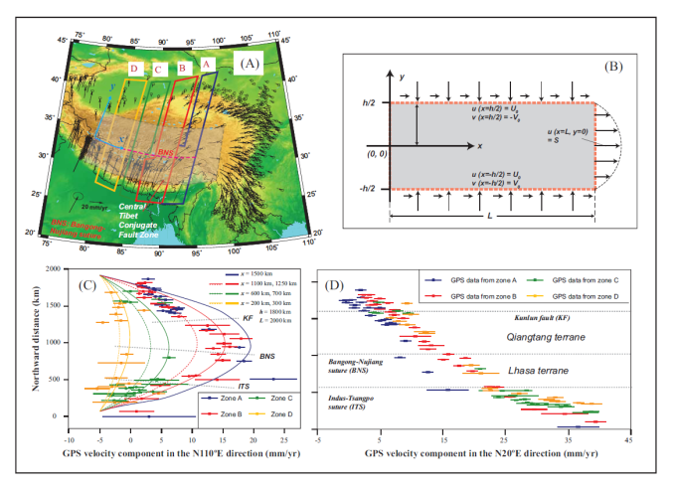
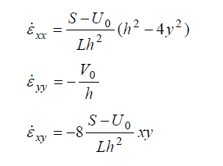
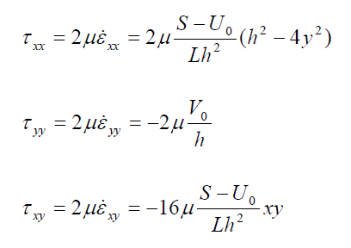
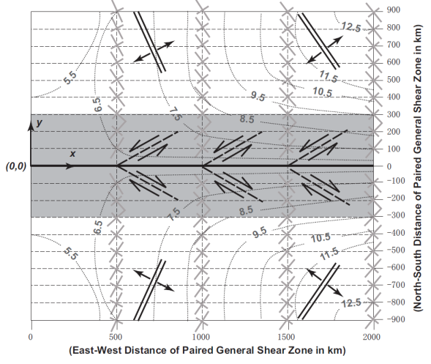
Mechanics of V-shaped Conjugate Strike-slip Faults
Yin, A., Dept. Earth & Space Sci., UCLA, Los Angeles, CA 90095
Observed
GPS data lead to
strain-rate field
Newtonian Fluid
Use stress field and
Coulomb fracture criterion
to predict V-shaped conjugate strike-slip faults

