Slide 1
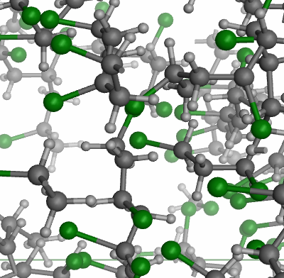
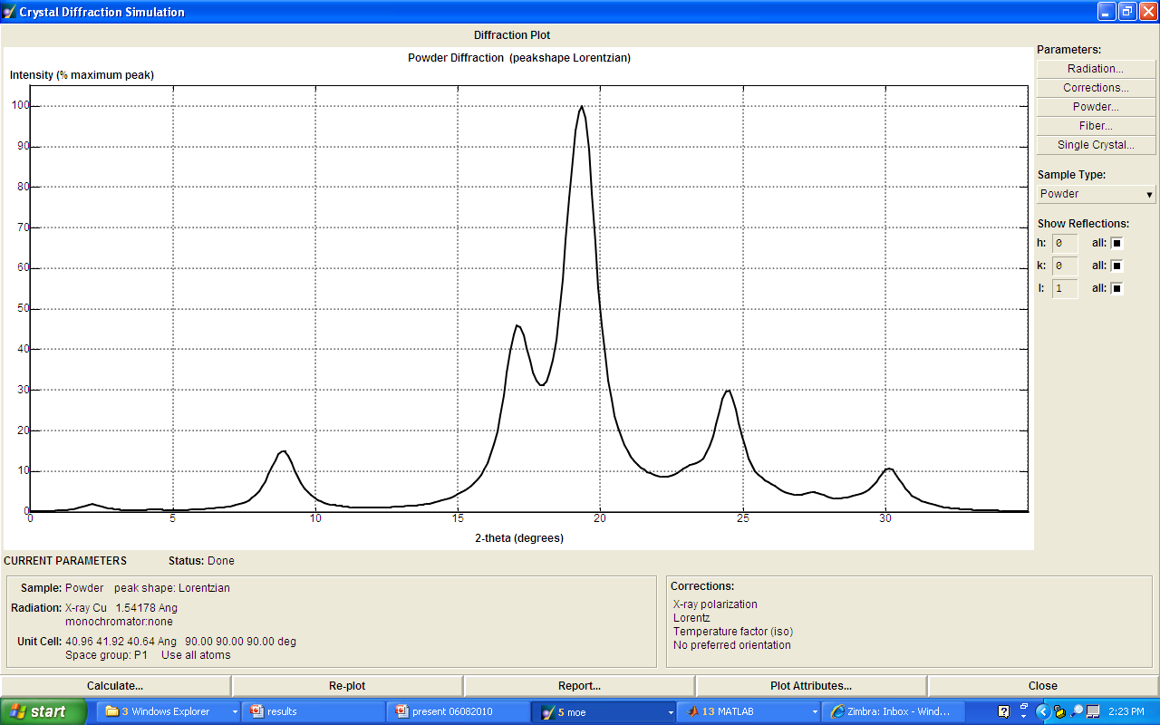
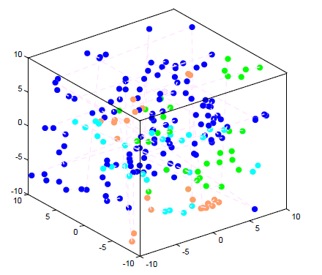
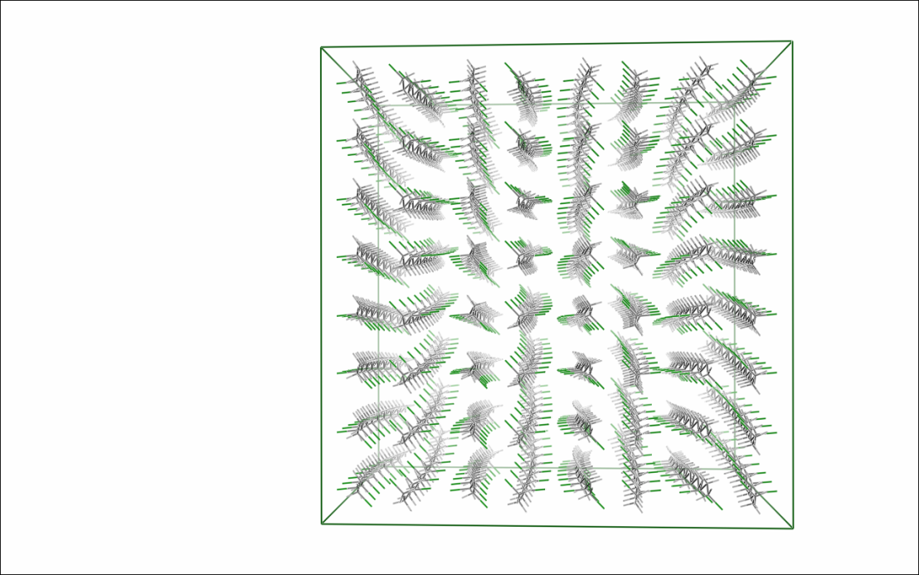
Extraction of critical structure from complex polymer simulations
Martha Grover and Pete Ludovice, Chemical & Biomolecular Engineering, Georgia Institute of Technology
In PVC, intermediate order produces a unique thermoreversible gelation property that makes PVC easier to process than its crystalline counterpart.
Current computational capability does not allow us to evolve molecule dynamics simultions to reach the desirable state, i.e. intermediate order, where we can analyze the system properties.
We have developed a model reduction approach to reduce the simulation burden.
Local feature analysis and time series methods are combined to speed up the simulation while retaining key features and dynamics.
MD Model reduction
WAXD Curve
Target conformation Recovery

Slide 2
Sdfs
Sdfsdfs
sdfkld

