Slide 1
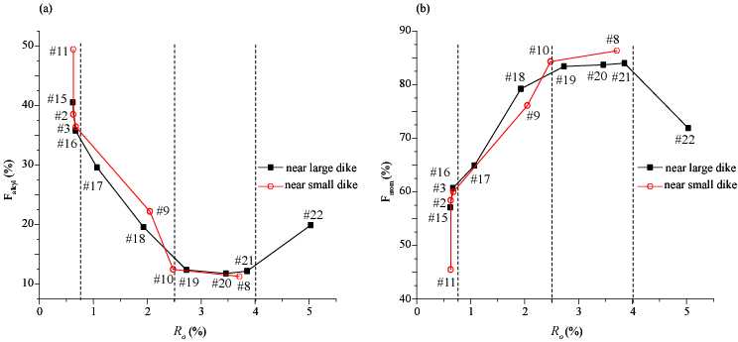
Insights into molecular structural changes of kerogen during thermal evolution investigated by advanced solid-state NMR spectroscopy
Jingdong Mao Department of Chemistry and Biochemistry, Old Dominion University, VA, 23508
With increasing R_{o} towards dike contacts, the coal kerogens generally display a trend toward lower alkyl contents (Fig. a) and higher aromatic abundances (Fig. b).
The thermal evolution of F_{alkyl} and F_{arom.} can be divided into three stages.
First, gradual loss of alkyl carbons and enrichment of aromatic carbons with R_{o} around 0.6% ~0.7%. Subsequent fast depletion of alkyl carbons leads to fast increase of aromatic content before R_{o} reaches ~2.5%. Then comparatively constant composition of alkyl and aromatic carbons is observed with 2.5% <R_{o}<4.0%.

