Slide 1
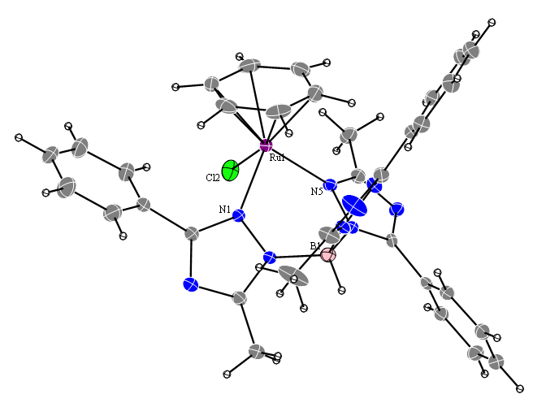
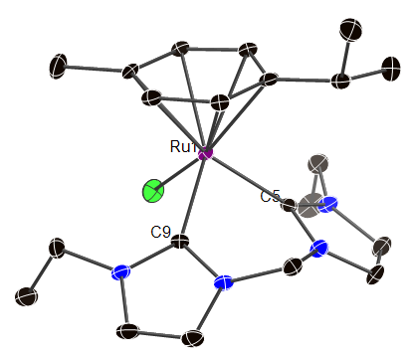
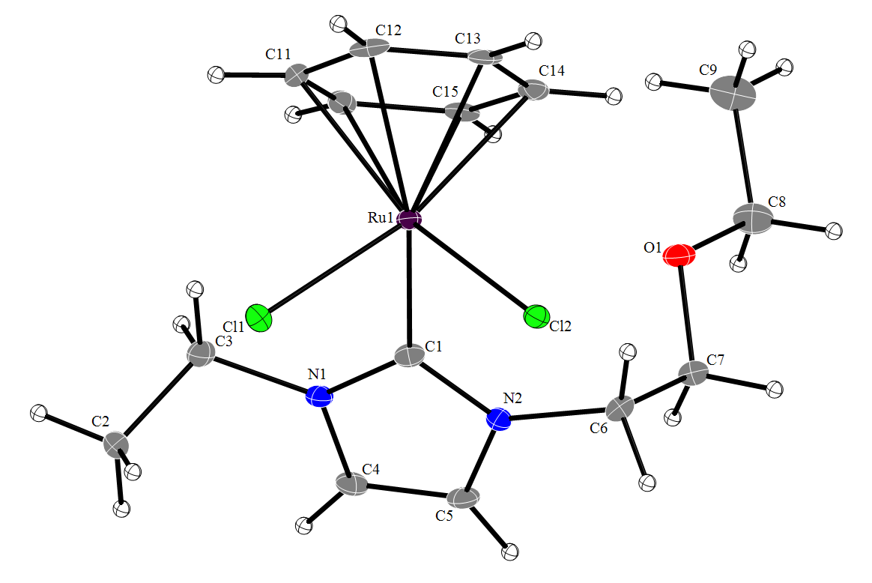
Novel Water-Soluble N-Heterocyclic Carbene Chelates for Transition Metal Catalysts Dr. Elizabeth T. Papish, Dept. of Chemistry, Drexel University Transfer Hydrogenation achieved with Ttz and NHC Ligands:
NHC complexes give faster catalysis w/ most substrates than Ttz complexes, however Ttz complexes perform better than similar Ru Tp complexes in the literature
Catalysts are robust and air stable, high % conversions, good functional group tolerance
Complexes with pendant ether and alcohol groups synthesized, may provide H+ relay sites or hemi-labile groups. Similarly uncoordinated triazole in Ttz, can be a pendant base.
Future goals: enantioselectivity, H bonds closer to the metal, use of H₂ gas
2˚ or 3˚ amine
Neutral or anionic
Bidentate or tridentate
Notes:
Allude to Sam’s results as a future direction – interested in putting amino groups near the metal center for hydrogenations cats that have built in cites for proton relay
Joe: does NHC work w/o base?

