Slide 1
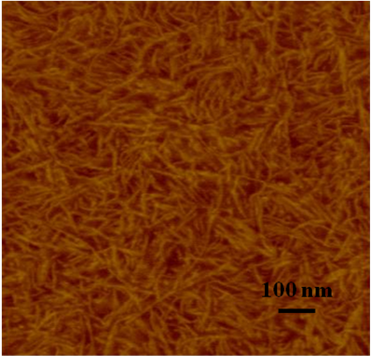
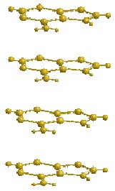
Supramolecular Architecture for Improved Processibility and Performance: Implications for Self-Healing and Alternate Energy
Timothy E. Long,* Shijing Cheng , and Sean T. Hemp Department of Chemistry, Macromolecules and Interfaces Institute, Virginia Tech, Blacksburg, VA 24061
Novel Supramolecular Polymers: Novel compositions were proposed that contain nucleic acid building blocks using simple derivatization of acrylate based monomers. These nucleobase units mircophase separated and reinforced amorphous copolymer matrices wherein the intermolecular interactions (π- π stacking and complementary multiple hydrogen bonding) enabled self-healing.
Our research program identified a new family of nucleobase-containing copolymers that self assembled into reversible macromolecular architectures. The foundation for this platform is based on our synthetic approach to well-defined macromolecules with precisely defined molecular weights and backbone functionality.
Schematic representation of our hypothesis of microphase separation driven by π- π stacking interactions
Tapping mode AFM phase image of poly(nBA-co-adenine acrylate) films with 15.6 mol% acrylate adenine

