Slide 1
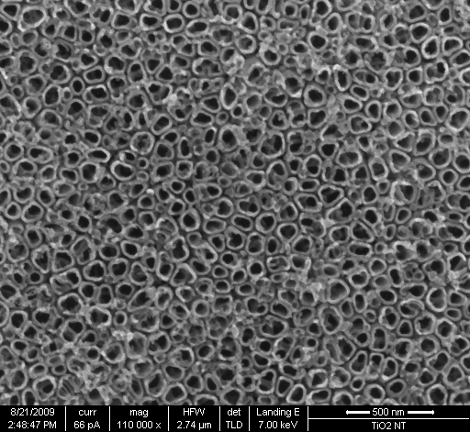
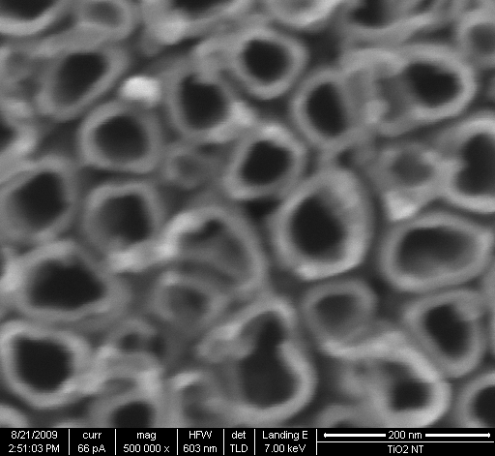
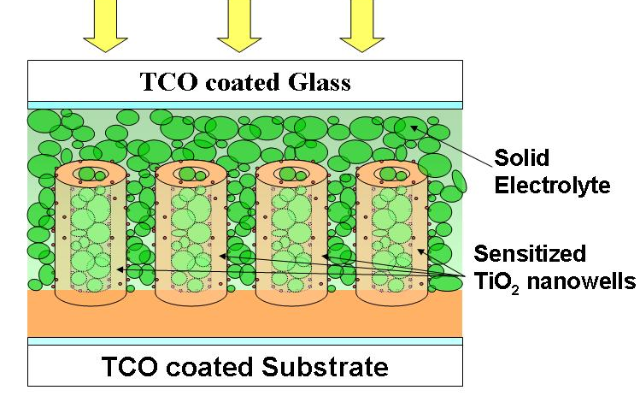
Solid-State Dye-Sensitized Solar Cells: Fabrication and Fundamental Investigations
Department of Materials Science & Engineering, University of Utah Salt Lake City, UT 841120
We have developed a technique of synthesizing nano-well like electrodes for SS-DSSCs. In fig.1 we have shown the SEM images of some of the nano-well like structures prepared by our technique. Walls of these wells are 5-10 nm thick while their bore diameters are in the range 100-150 nm. Because of the unique nanoarchitectures, these electrodes possess very large surface area while maintaining sufficient spacing/opening for loading solid electrolyte in the structure. Using these TiO₂ nano-well electrodes we are fabricating SS-DSSCs (fig.2).
Fig.1: SEM images of TiO₂ nano-wells: (a) low magnification (b)high magnification.
Fig.2: Schematic of our nano-well based SS-DSSC.

