Slide 1
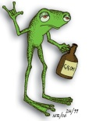
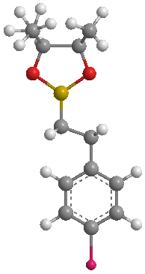
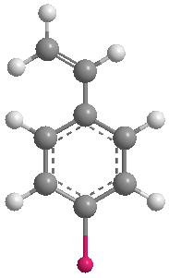
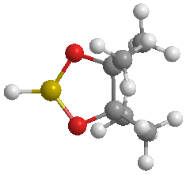
Copper Zwitterions for the Generation of Hydrogen Stephen A. Westcott, Mount Allison University
We have begun to develop novel zwitterionic copper complexes containing unique arylspiroboronate ester ligands for their potential to act as catalysts for the dehydrogenation of ammonia-borane. Initial work with a bulky spiroboronate ester derived from 3,5-di-tert-butylcatechol shows that the formation of cationic species are favored. We are presenting looking at using other catechol derivatives as well as other metal complexes for their catalytic ability. Preliminary work has shown that a novel iridium arylspiroboronate ester complex can be used as a precatalyst for the addition of pinacolborane to vinyl arenes.¹
5 mol% catalyst
+
R = OMe, F, Bpin
HBpin
1. ‘Catalytic hydroboration of vinylarenes using a zwitterionic arylspiroboronate ester iridium complex’
Melanson, J. A.; Vogels, C. M.; Decken, A.; Westcott, S. A.* Inorg. Chem. Commun. 2010 accepted.

