Slide 1
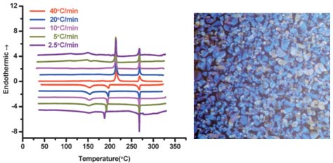
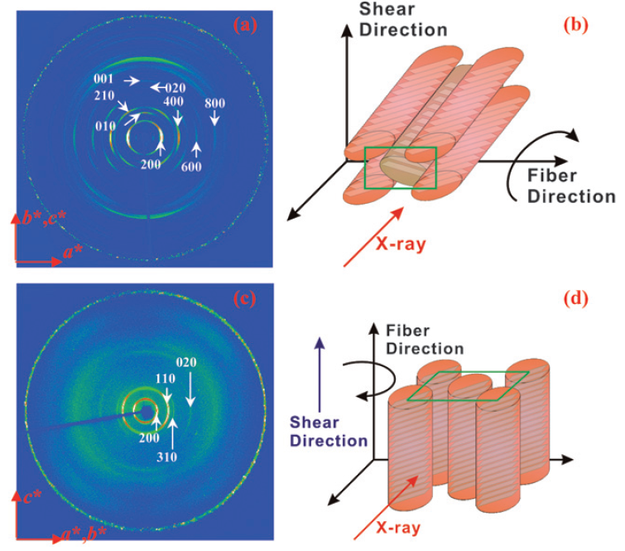
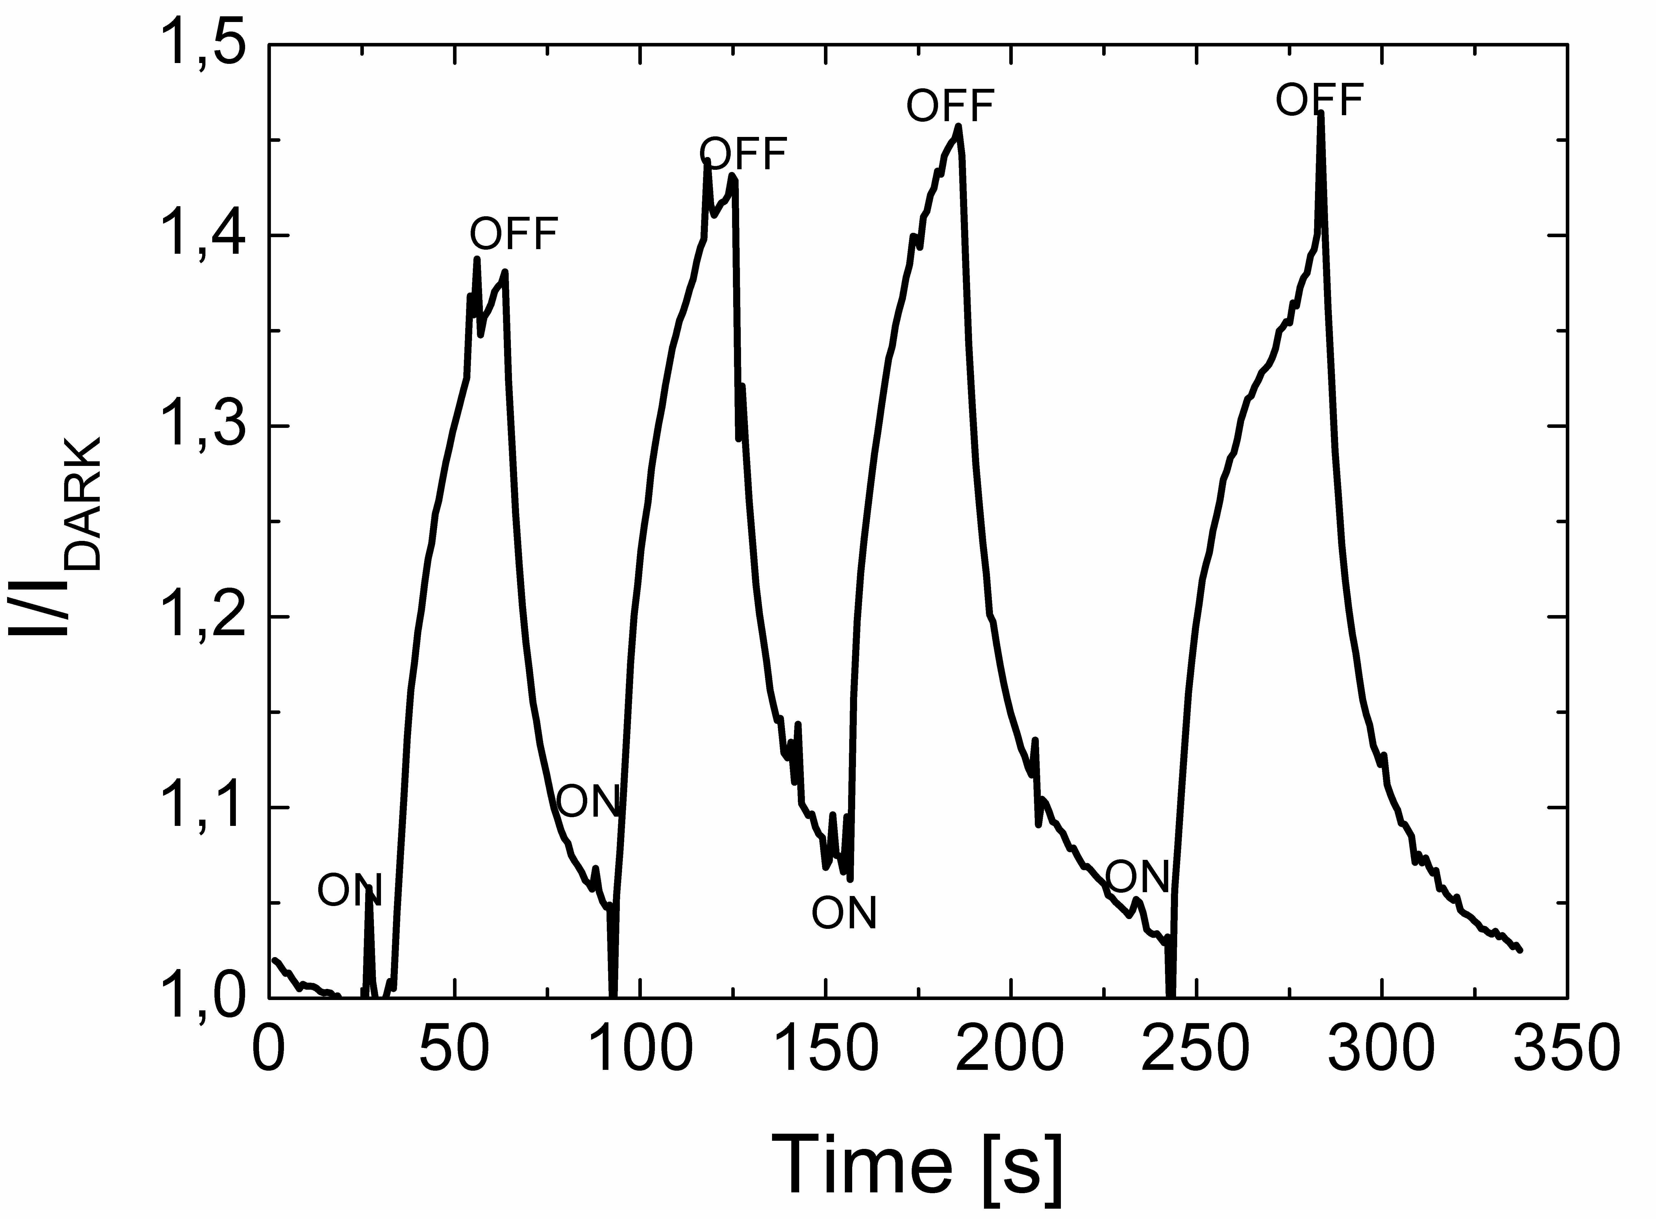
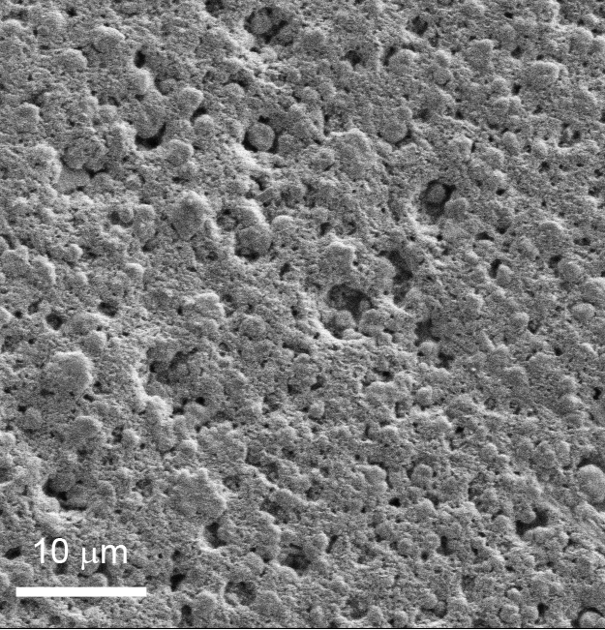
Design and Synthesis of Novel Pyrene Discotics and Their Investigation in Organic Photovoltaic Cells
Bilal R. Kaafarani, Department of Chemistry, American University of Beirut, Beirut, Lebanon
K₂ Phase
K₃ Phase
K₄ Phase
DSC, 1D WAXD, 2D WAXD, and PLM results of TQPP-[t-Bu]₂-[OC₁₀H₂₁]₄ showed that this compound possesses a DLC phase.
Films deposited from butylamine-modified graphene sheets/TQPP-[t-Bu]₂-[SC₆H₁₃]₄ blend showed a photoelectrical response higher than those prepared with neat molecule or GSs/TQPP blend.
Soft Matter 2010, 6, 100; J. Phys. Chem. C 2010, 114, 11252.

