Slide 1
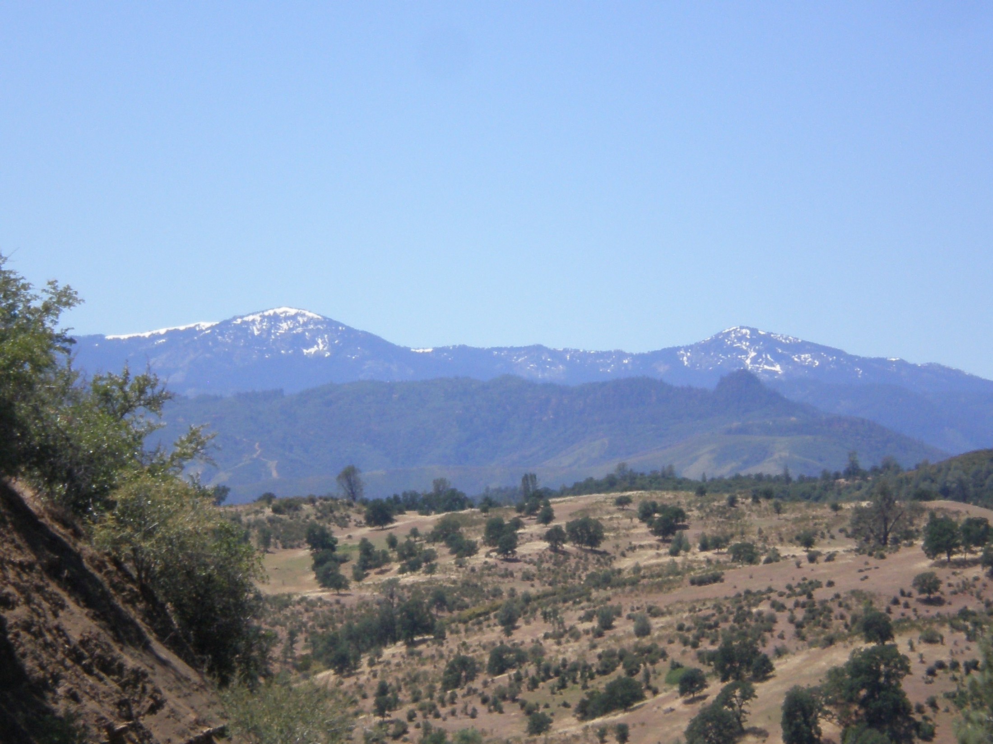
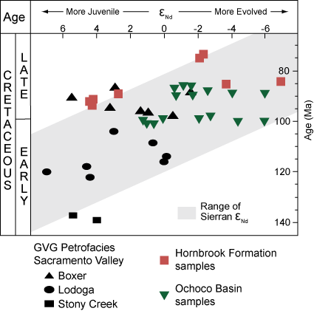
Determining Cretaceous Paleogeography through Sedimentary Geochemistry: Relationships between the Hornbrook Formation, Ochoco Basin, and Great Valley Group
Kathleen D. Surpless, Department of Geosciences, Trinity University, San Antonio TX 78212
Significant results:
Trace-element geochemistry of the Hornbrook Formation and the Ochoco Basin suggests a combined Hornbrook-Ochoco basin, consistent with detrital zircon ages.
Whole-rock neodymium isotopic analysis of samples from the Hornbrook Formation , Ochoco Basin, and northern Great Valley Group display significant overlap and are consistent with provenance in the Sierran arc.
Together, these three basins contain sediment derived from the northern Sierran arc, Klamath Mountains, and Blue Mountains; results suggest that the three basins may have been one single system.
Continuing work:
Verify and document apparent overlap in geochronology and major-and trace-element geochemistry to test spatial versus temporal relationships throughout the Hornbrook Formation, Ochoco basin, and Great Valley Group.

