Slide 1
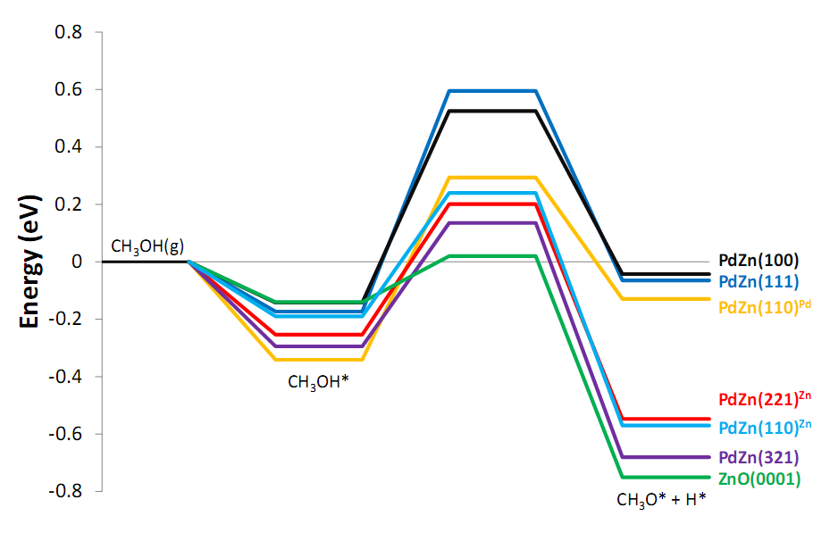
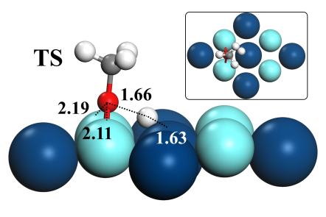
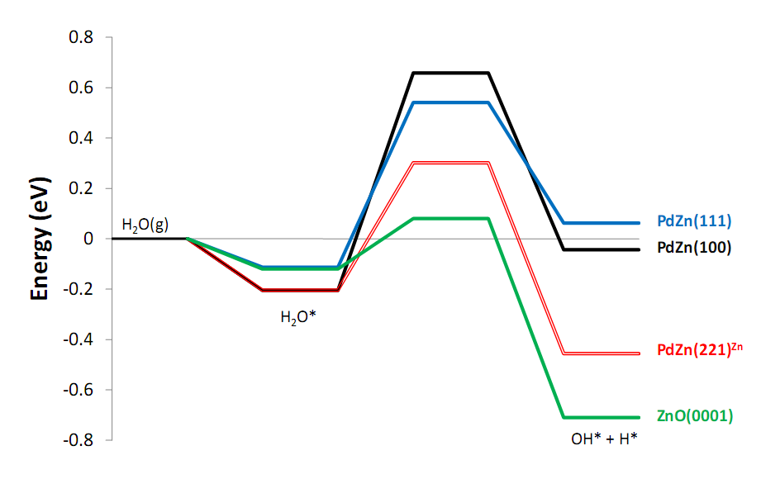
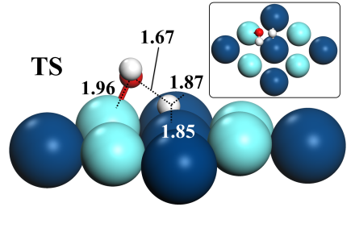
Density functional theory studies of initial steps in methanol steam reforming on PdZn and ZnO
Hua Guo
Methanol steam reforming (MSR) is an attractive approach to on-board H₂ generation for fuel cells. To understand the mechanism of MSR on a new PdZn/ZnO catalyst, planewave density functional theory calculations are performed for the initial steps of MSR PdZn and ZnO surfaces. It was found that both CH₃OH and H₂O dissociation processes are highly activated on PdZn surfaces, although defect sites significantly lower the barriers. On the other hand, the same processes on ZnO surfaces are much more facile.
CH₃OH and H₂O Dissociation
Transition state geometry

