Slide 1
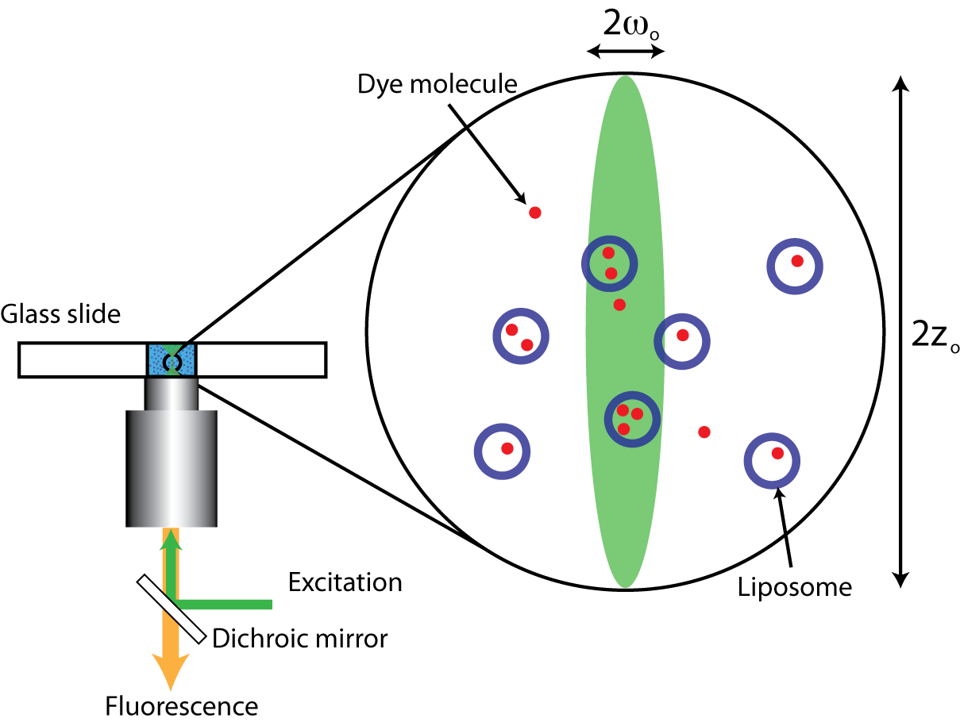
Dissecting the Dynamics of Surfactant Assemblies with Numerical Fluorescence Correlation Spectroscopy (NFCS)
Daniel L. Burden, Chemistry Department, Wheaton College
Wheaton, IL 60187
NFCS has been modified to more fully incorporate the dynamics of vesicles and micelles as they act as hosts to encapsulate other compounds. We published a paper dealing with the determination of molecular entrapment levels (Anal. Chem. 82, 180, 2010) and are now seeking to use the simulator for partitioning studies.
We have also completed work on the potential limitations that arise whenever the optical detection volume (DV) in FCS does not match the ideal Gaussian geometry ubiquitously assumed by FCS theory. In a manuscript submitted for publication, we employ numerical simulation to systematically explore the influence of DV geometry. Using different levels of DV distortion, we delineate a range of conditions that are necessary for obtaining accurate FCS results and show experimental circumstances that should be generally avoided.

