Slide 1
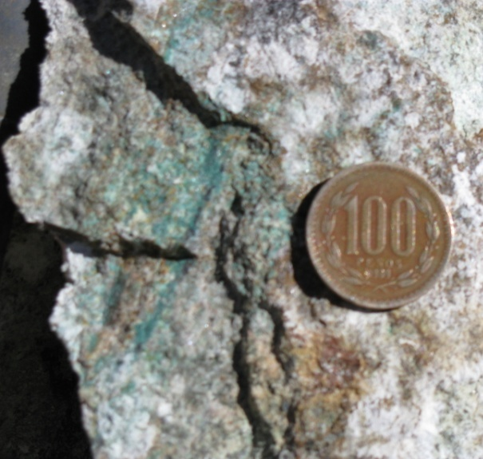
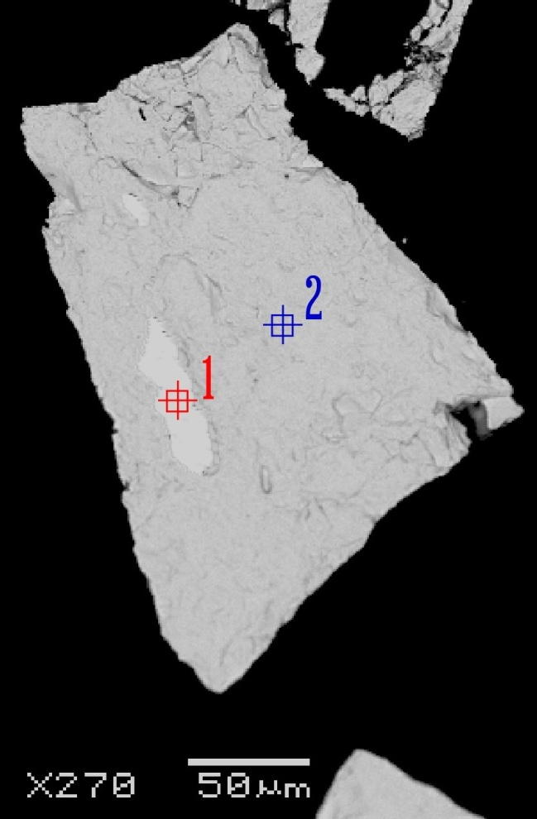
Experiential Learning at Hispanic-Serving Institutions: Si Se Puede!
The rare greenish-blue copper nitrate mineral Gerhardtite (sample on left) was discovered by our team at three new sites in the Atacama Desert of Chile. Preliminary nitrogen and carbon stable isotope work
identified that this rare mineral forms only
during the most recent period of
Nitrate development.
SEM, EDS, and Electron Probe work (sample on right) has identified inclusions of hydrocerussite (bright spot #1) contaminating lab-grown cerussite (grey spot #2). This discovery has led to the development of a new, more reliable oxygen isotope thermometer for cerissite:
1000 ln α cerussite-water = 2.29 (10⁶/T²) - 3.56

