Slide 1
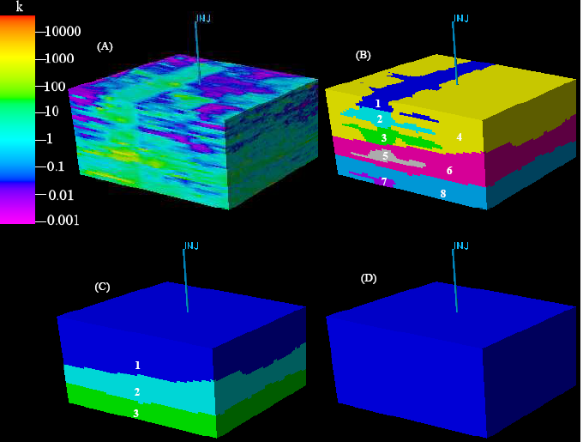
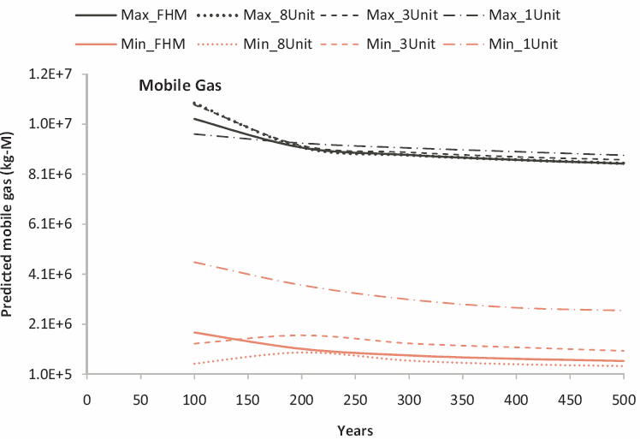
Seeking Optimal Geologic Models in CO₂ Storage Simulation
Ye Zhang, Depart. of Geology & Geophysics, University of Wyoming, Laramie, WY, 82071
To assess a CO₂ storage site, reservoir simulation
is performed using a site geologic model. Since data needed to build a detailed site model are often unavailable, simple stratigraphic models are built in which facies or depositional zones are assumed homogeneous. Within a full parameter space, this study explores the adequacy of such models in representing natural systems. We seek an optimal model complexity that can lead to a cost-effective strategy in data collection and reservoir modeling. For a suite of equivalent models (right), a design of experiment (DoE) and response surface (RS) methodology is used to conduct a parameter sensitivity and prediction uncertainty analysis.
Model equivalence is ensured via permeability upscaling.
Heterogeneous model
Facies model
Depositional model
Formation model
Prediction envelop (mobile CO2) created by RSs developed for each model.
DoE results at 2 km depth including parameters important to predictions.

