Slide 1
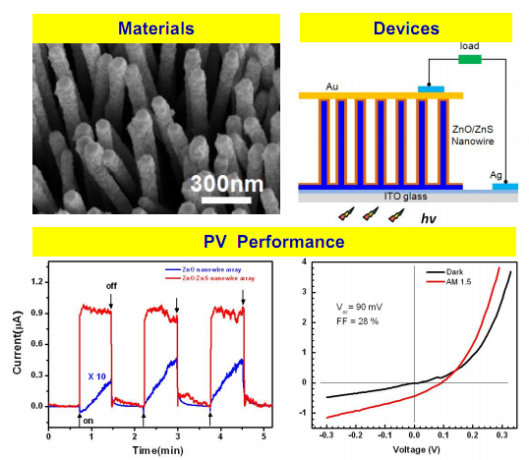
Direct Growth of Type II Core/Shell Nanowire Array on Transparent Conducting Oxide (TCO) Substrate for Potential Solar Cell Application
Weilie Zhou, Advanced Materials Research Institute, University of New Orleans. New Orleans, LA
Motivation We aim to grow three dimensional nano-architectures with type II band alignment in core/shell geometry for potential photovoltaic (PV) device fabrication.
Progress We have successfully achieved preliminary PV devices based on ZnO/ZnS core/shell NW arrays, which were vertically assembled on indium-tin-oxide transparent glass by combining chemical vapor deposition and pulsed laser deposition routes. The obvious charge separation functioned by type II heterojunctions was observed and the final conversion efficiency was determined as 0.1%.
Plans To improve the conversion efficiency of the type II PV devices, our further plan will be focused on optimizing the parameters of synthesis of materials and fabrication of devices, designing novel ZnO nanostructure with controllable geometries, and searching for II-VI semiconductor combinations with less lattice mismatch .

