Slide 1
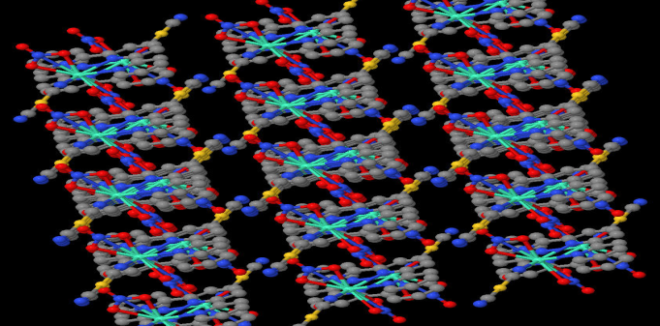
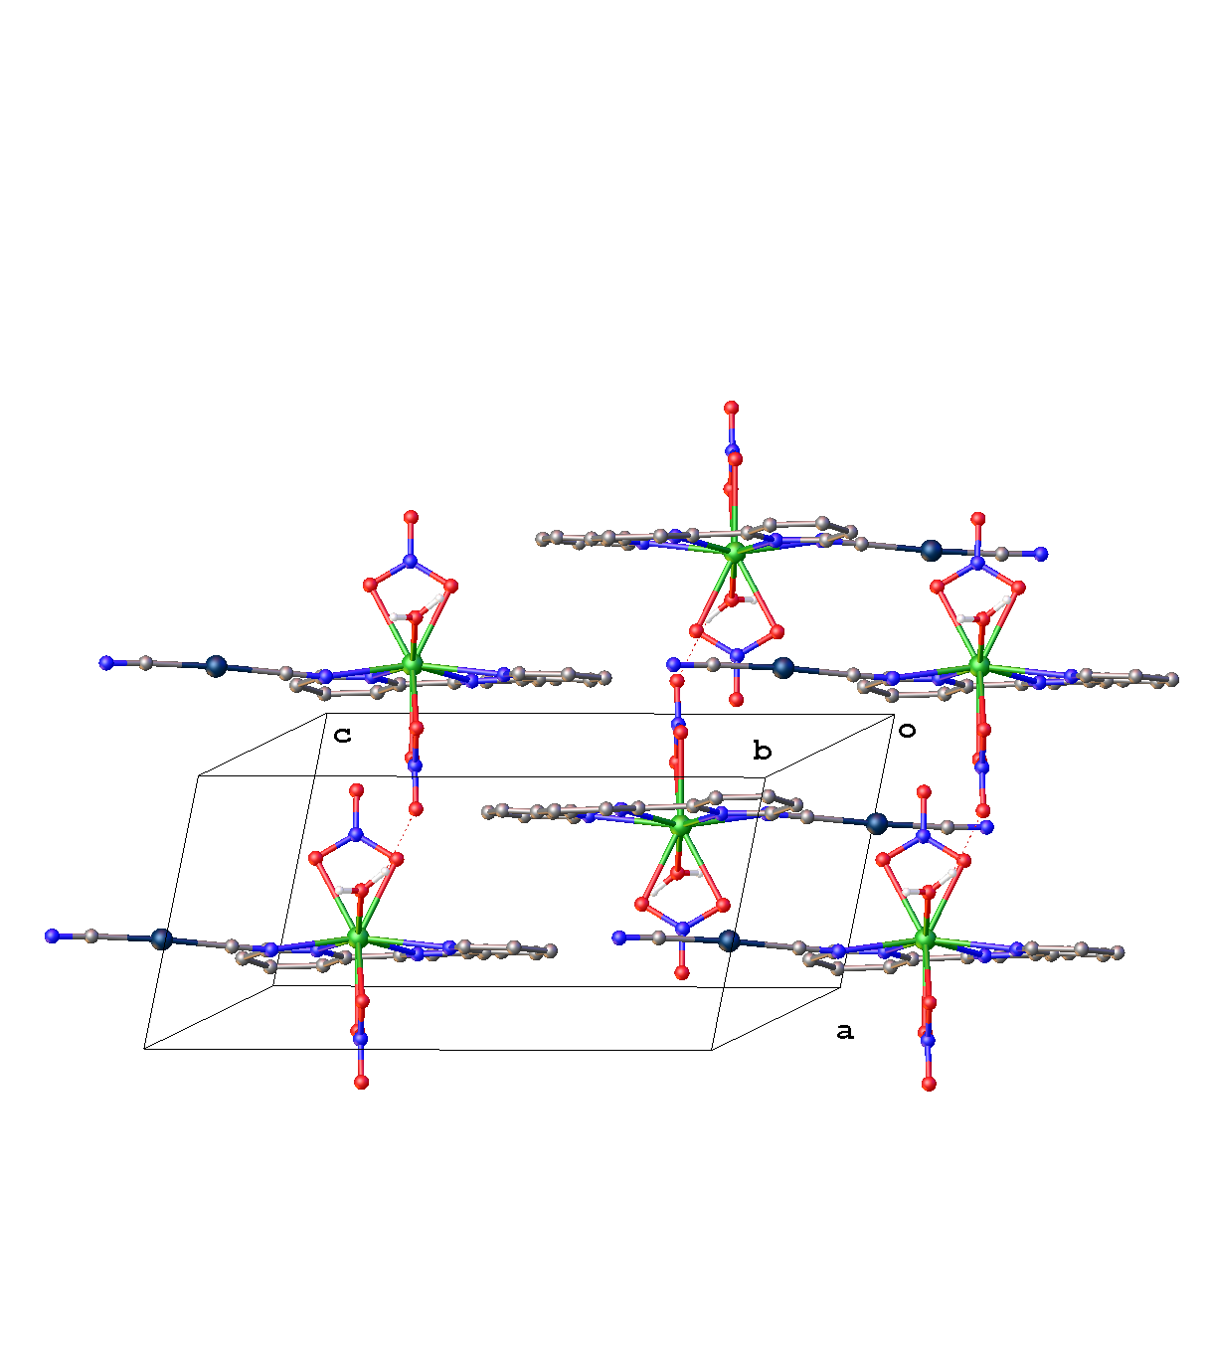
Disruption of Metal-Metal Interactions and Extended Linear Chains by Organic Solvent Molecules
Zerihun Assefa, Chemistry Dept.,
NCAT State University, Greensboro, NC 27411
Cyanide-bridged heterometallic systems that are prepared by assembling cyanometallates, e.g. [Pt(CN)₄]^{2–}, and transition metals or lanthanide ions exhibit fascinating structural, birefringent, luminescent, and sensing properties. Apart from tetra and hexanuclear metallic arrangements, the materials exhibit interesting spectroscopic behaviors, where exciplex and excimer emissions dominate the spectral profile.
An unusual red emission is observed that originate from the formation of an excited state exciplex involving intermolecular pi-stacking of 2,2’:6’,2”-terpyridine ligands as shown in the figure.

