Slide 1
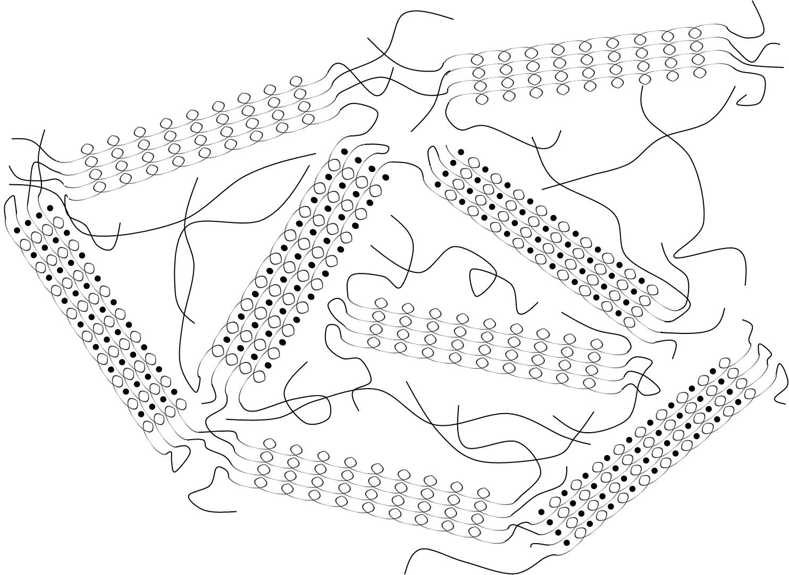
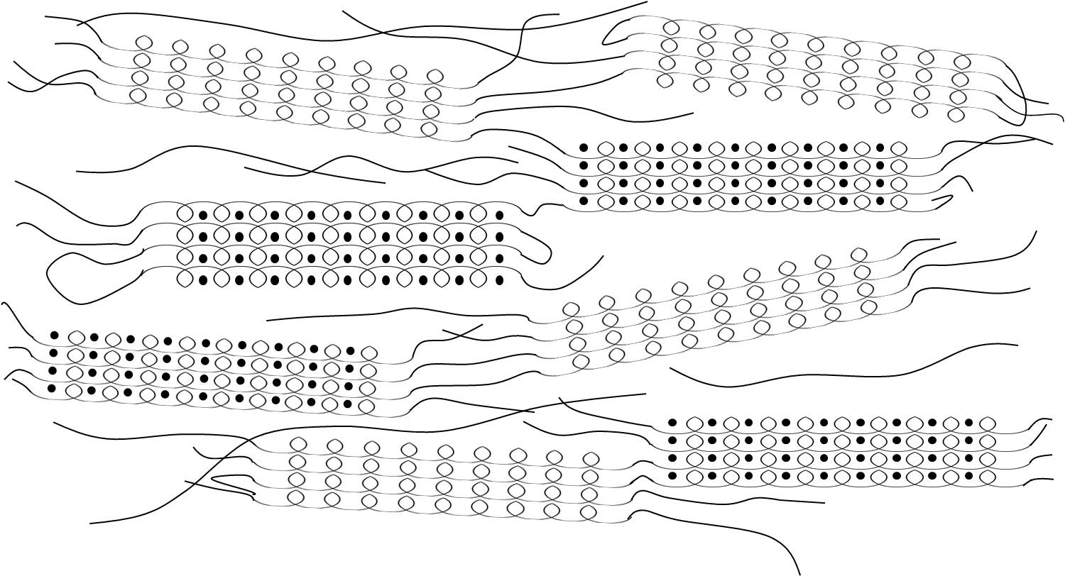
Polymer Chain Alignment and Conductivity for Polymer Electrolytes Relevant to Lithium Rechargeable Batteries
Christopher M. Burba, Department of Natural Sciences Northeastern State University, Tahlequah, OK 74464
The future success of developing all-solid-state lithium rechargeable batteries hinges on improving the poor ionic conductivities of currently available compounds. Conventional wisdom for increasing ion conduction is to decrease crystallinity in the electrolyte. However, several striking examples of ordered polymer electrolytes with higher conductivities than analogous disordered systems questions the fundamental role of polymer chain order and ionic conductivity. This research systematically examined a family of poly(ethylene oxide)-based polymer electrolytes in which the constituent polymer chains are organized through of tensile stretching. Polarized FT-IR spectra provide missing quantitative information concerning the degree of polymer chain organization as well as temperature-dependent relaxation rates for the oriented materials.
STRETCH
Notable Achievements
Determining that the relative rate of alignment is the same for the PEO and PEO-salt phases present
in a polymer electrolyte
Polymer chains become oriented through a process of stress-induced melting followed by
recrystallization with the helical axes parallel to the stretch axis.
Spectroscopic data support the notion that conductivity enhancement is due to the alignment of
polymer chains along the stretch direction.

