Slide 1
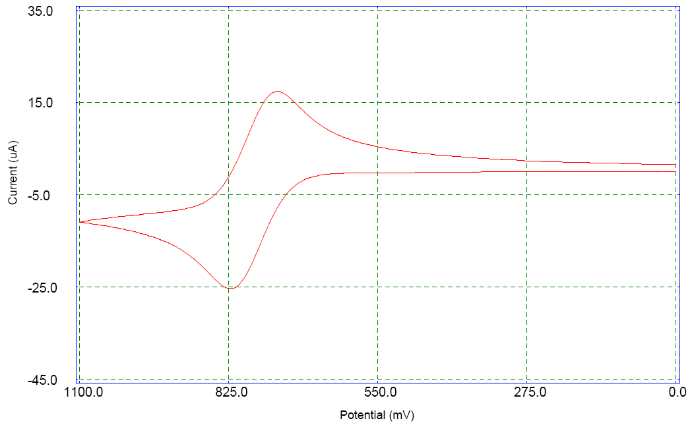
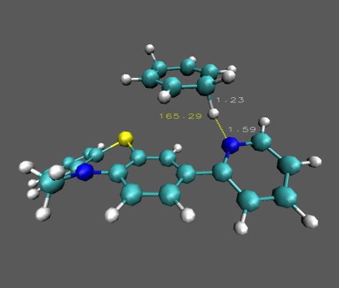
Investigating Proton-Coupled Electron Transfer with Radical Cations Appended with Bases
Ian J. Rhile, Department of Chemistry and Biochemistry, Albright College, Reading, PA
Base-appended radical cations have the potential to transform hydrocarbons into synthetically useful compounds after abstracting hydrogen atoms. The cyclic voltammogram of compound MPT-pyr is reversible, indicating unusual radical cation stability on the electrochemical timescale. Chemical oxidation provides a colored compound, that reacts with 1,4-cyclohexadiene to form benzene. Calculations indicate a concerted mechanism.
MPT-pyr

